Slide 1
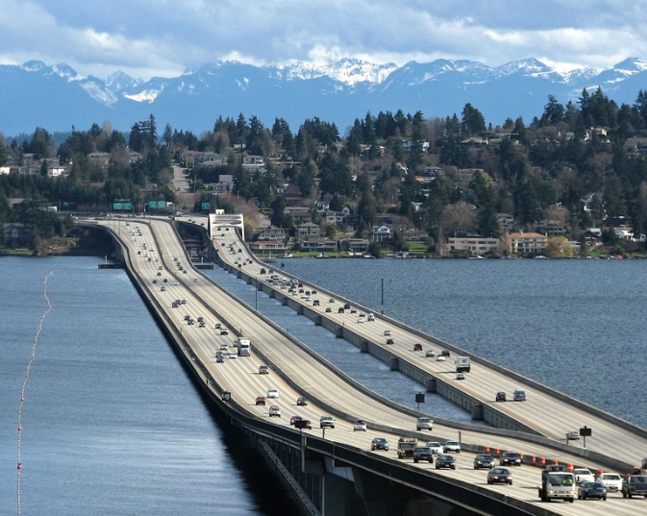
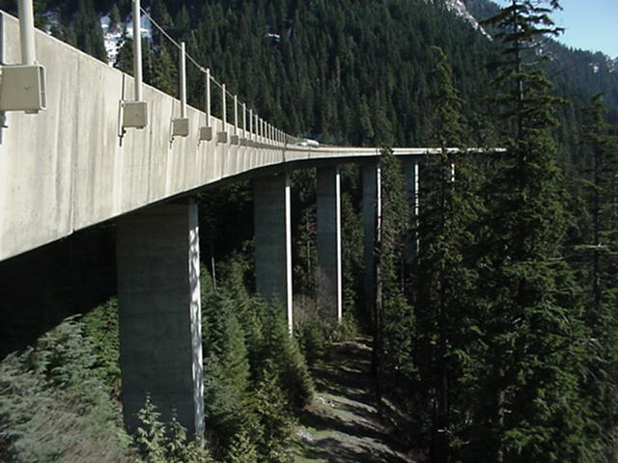
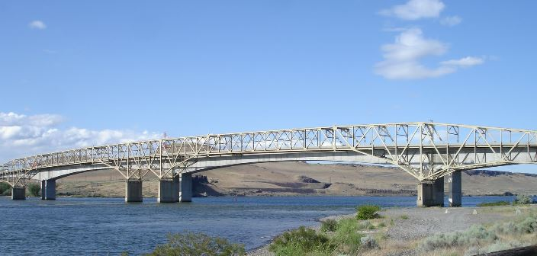
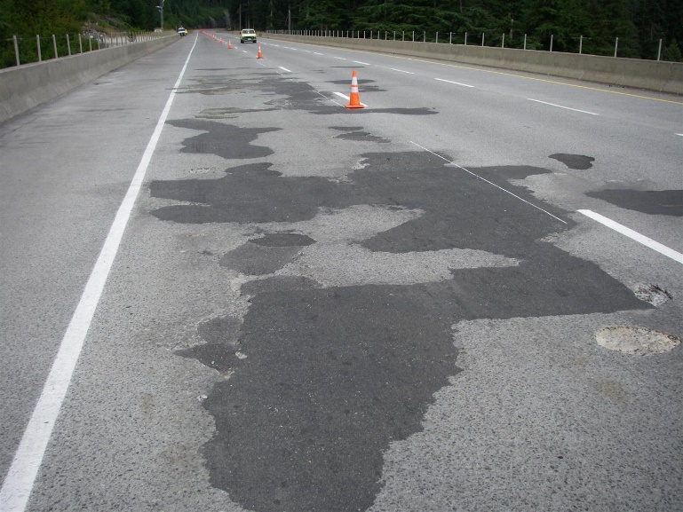
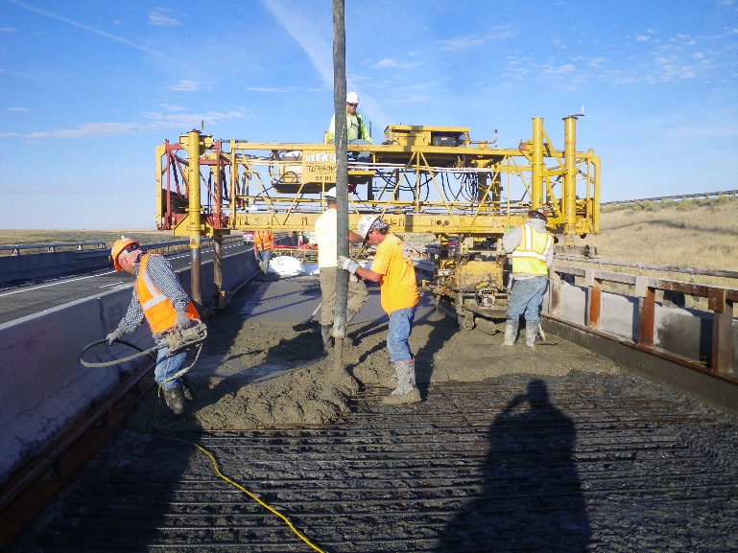
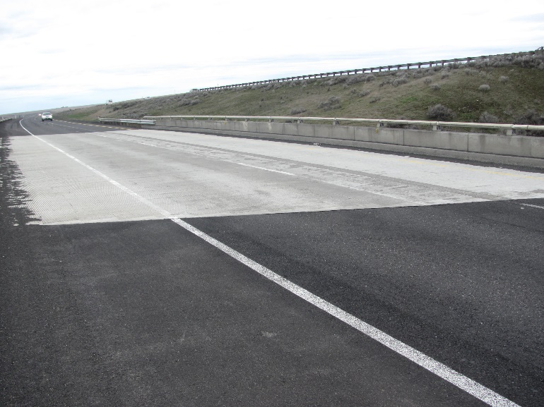
Part 2: WSDOT’s Bridge Deck Preservation Program

Slide 2
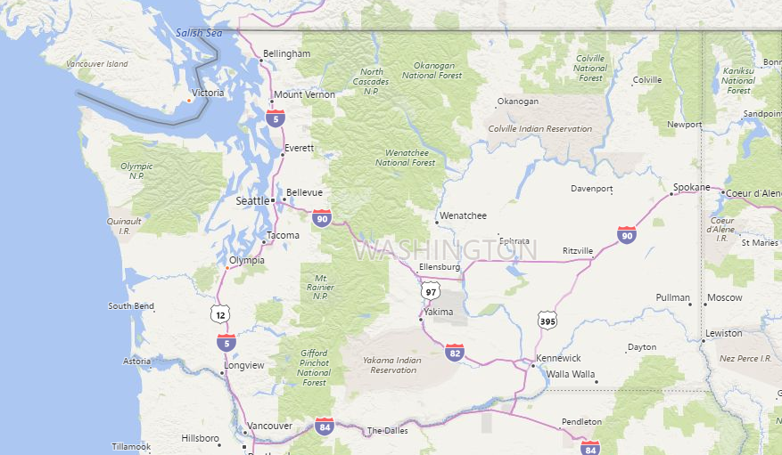
Washington State Map
Eastern Washington
Western Washington
Notes:
Washington State has three distinctive areas, Eastern, Western Washington and the Cascade Mountains.

Slide 3
Washington State’s Bridge System
3,132 bridges (53.5 M SF)
Repl value $58 Billion
Superstructure Types
Deck Types
Ave Age - 48
2,964
Integral
Non-Integral
60
% based on bridge deck area
Nearly 90% of WSDOT bridges built in the past 10 years
are precast prestressed/post-tensioned concrete

Slide 4
WSDOT Conc Bridge Deck Condition
3,024 WSDOT Bridges with Conc Deck
Fair
807 brgs
17.5M SF
Good
2,110 brgs
26.3M SF
38.4%
57.7%
Poor
107 brgs
1.8M SF
$180M to Repair/overlay

Slide 5
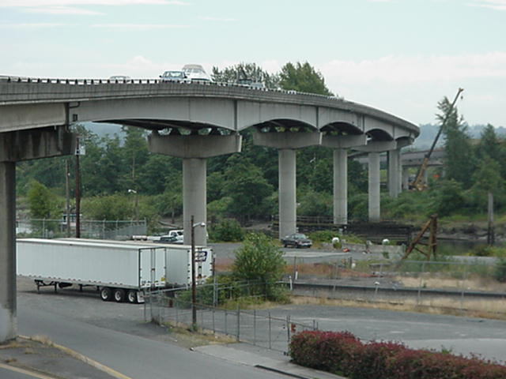
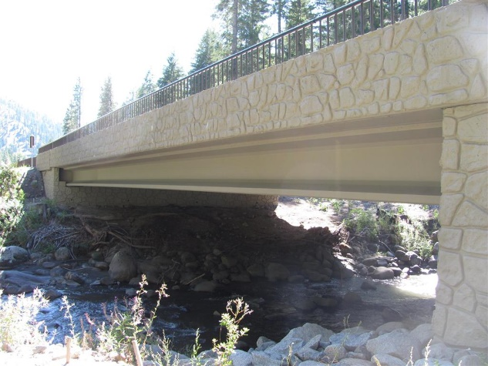
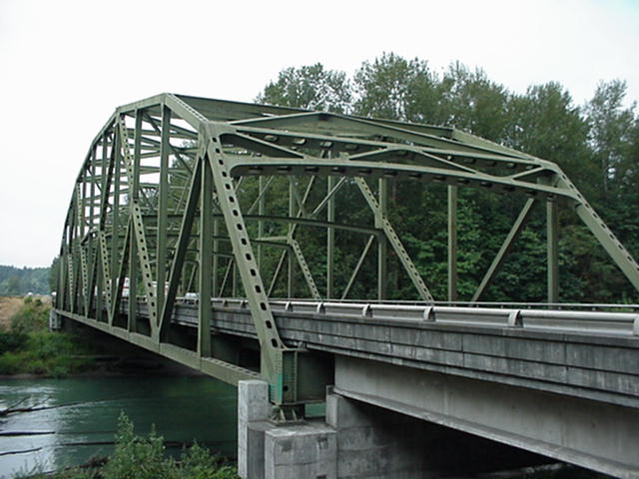
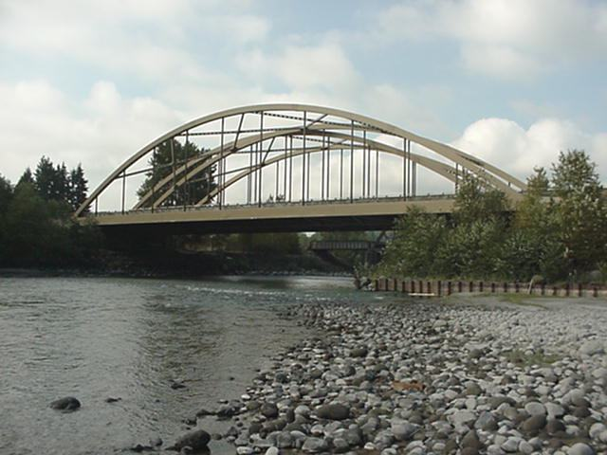
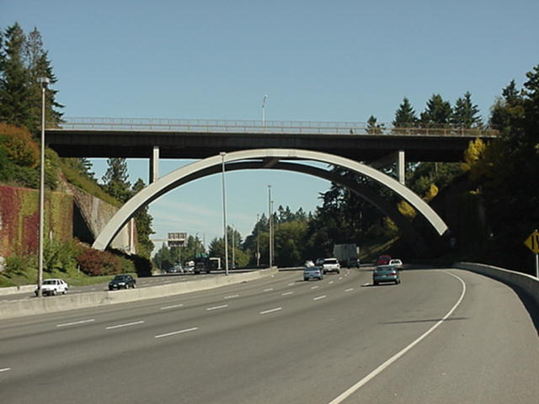
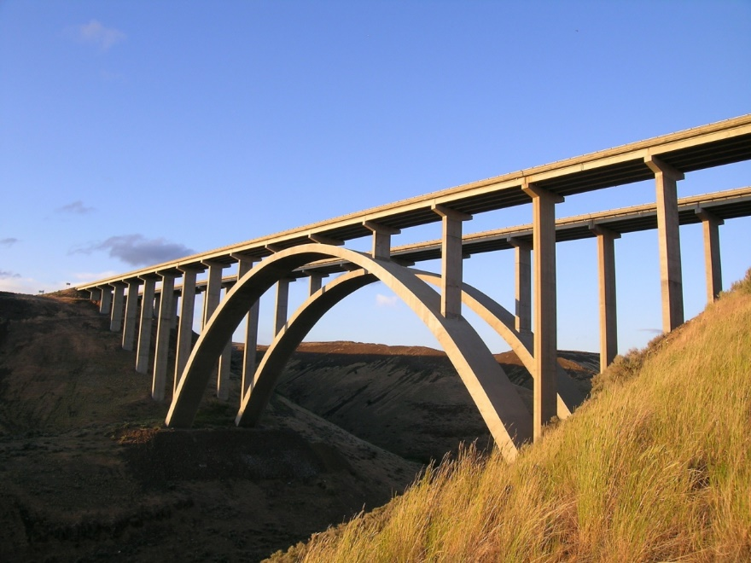
WSDOT Concrete Bridge Decks (non-Integral)
Steel Girder
Prestress Girder
Steel Truss
Steel Arch
Steel Arch
Concrete Arch
Notes:
3

Slide 6
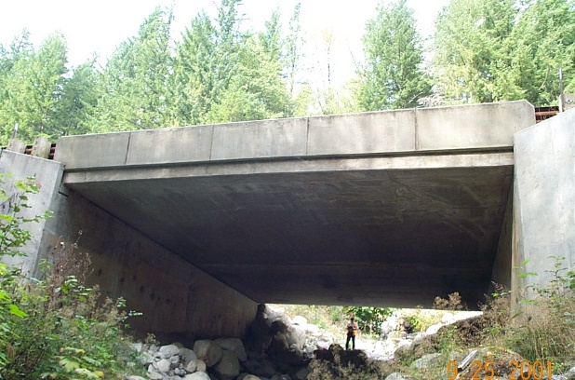
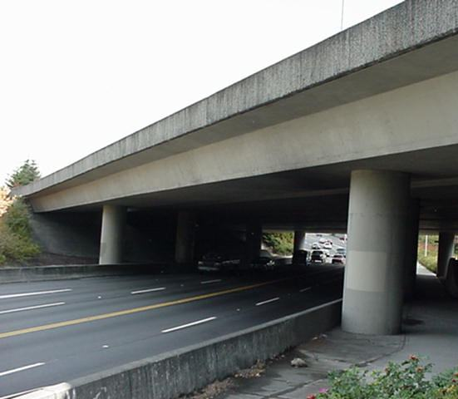
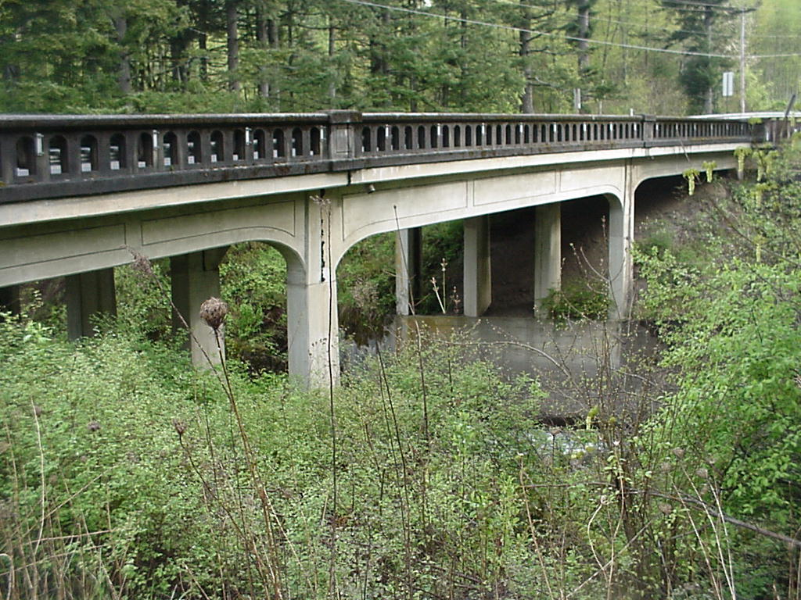

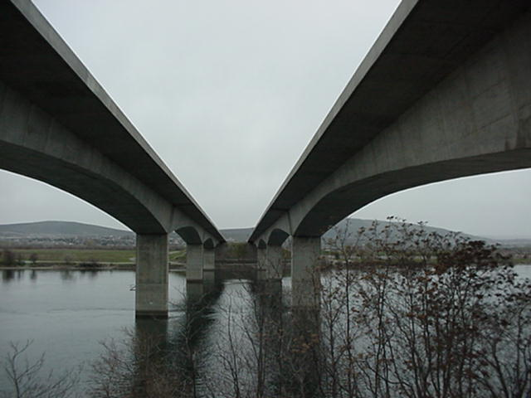
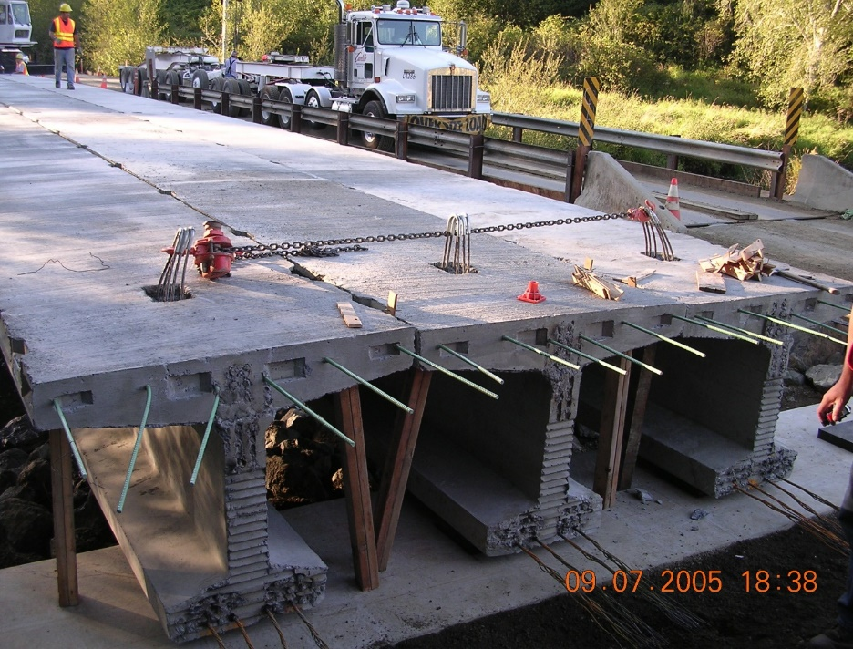
WSDOT Concrete Bridge Decks (Integral)
Conc Box
Conc T-Beam
Precast Prestress Slab
Floating
Bridge
Segmental Post-Tension Box
Prestress Bulb-T
Notes:
3

Slide 7
Typical Concrete Bridge Deck
Concrete Bridge Deck
Concrete Bridge Deck issues:
Deterioration /Rebar Corrosion
Rutting
Rebar Cover
Poor Quality Concrete
Notes:
3

Slide 8
Typical Concrete Bridge Deck
Deterioration / Rebar Corrosion
1.) salt & water penetrates concrete
3.) cracks form causing delams
2.) rebar corrodes & expands
Notes:
3

Slide 9
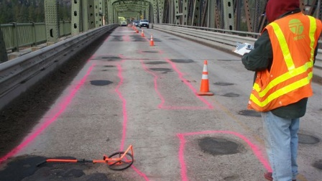
Typical Concrete Bridge Deck
Deterioration / Rebar Corrosion

Slide 10
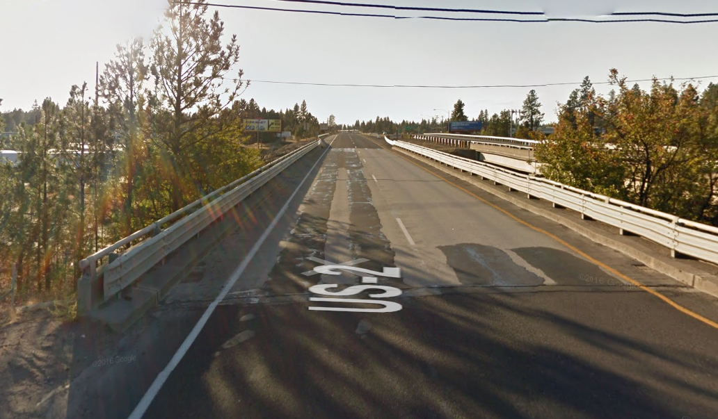
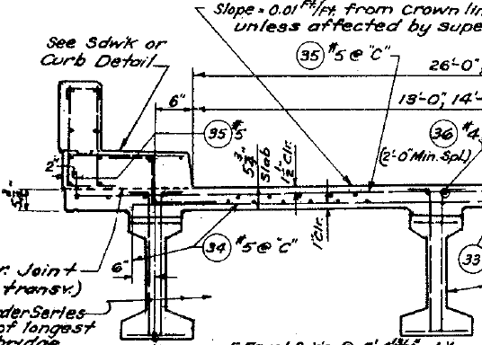
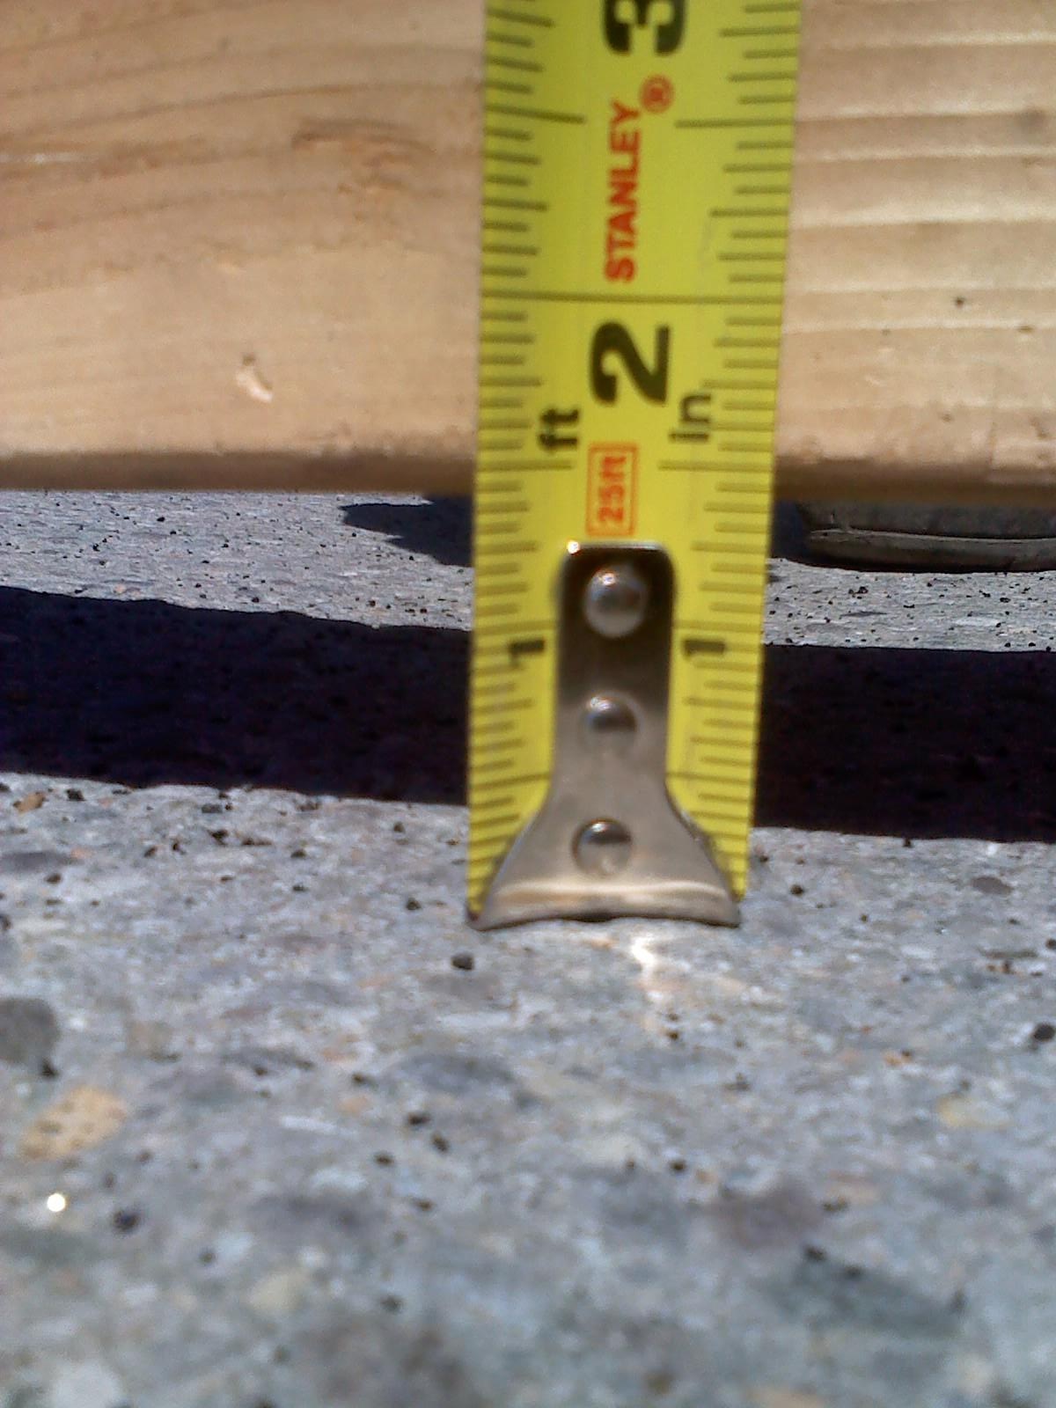
Typical Concrete Bridge Deck
Rutting
US2 Geiger Blvd OC
Spokane, Wa
Prestress Conc Girder
Deck – 5.75”
Year Built – 1964 (54yrs)
Conc Overlay – 1987 (31yrs)
WSDOT Maintenance crews
Applied urethane to wheel ruts in 2017

Slide 11
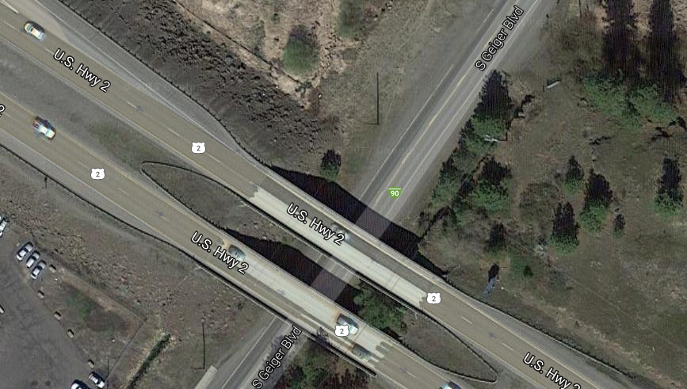
Typical Concrete Bridge Deck
Rutting
US2 Geiger Blvd OC
Spokane, Wa

Slide 12
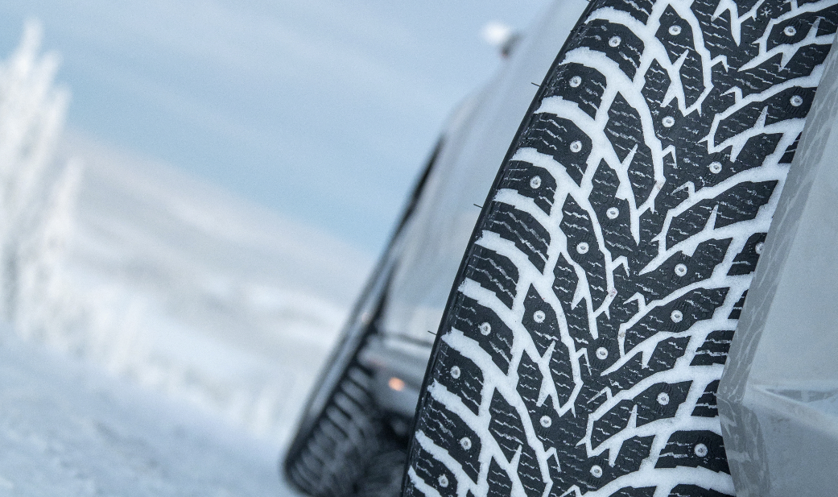
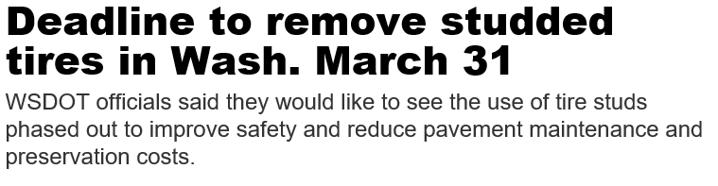


The only states that explicitly prohibit studded tires for residents year round are Hawaii, Minnesota, Mississippi and Wisconsin.

Slide 13
Typical Concrete Bridge Deck
Br 99/540 Alaskan Way Viaduct
Rebar Cover

Slide 14
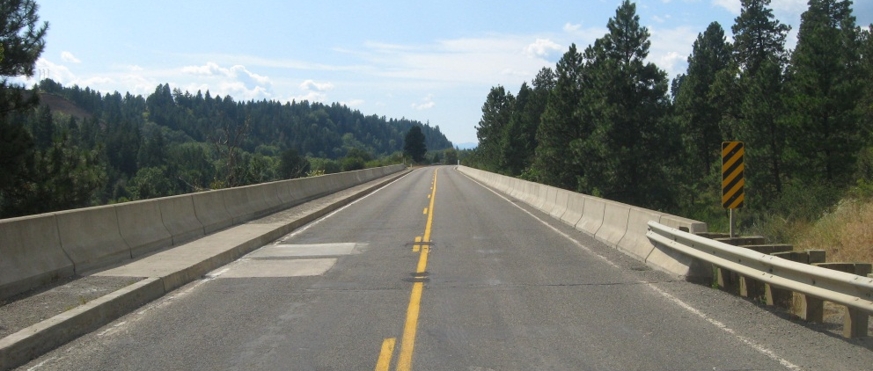
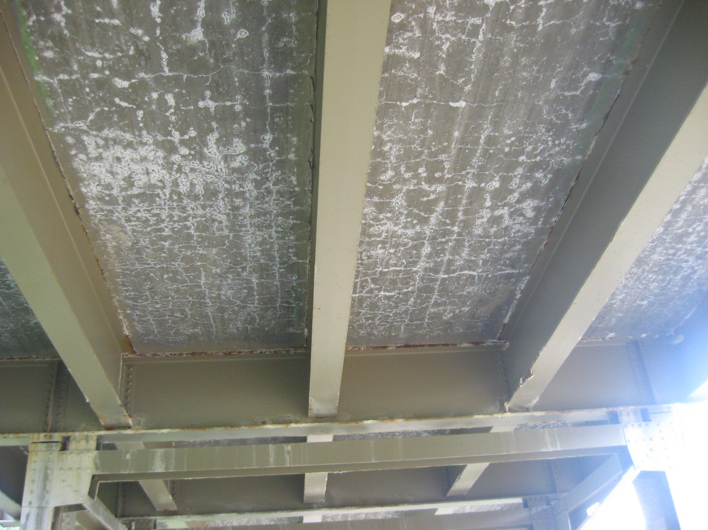
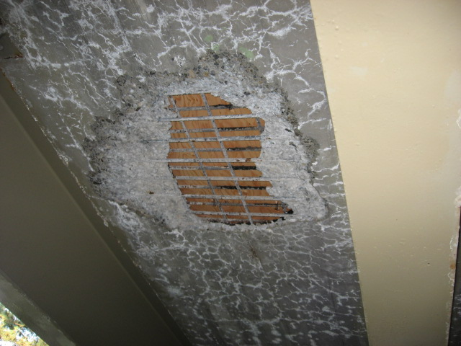
Typical Concrete Bridge Deck
Poor Quality Concrete
SR10 Bristol Fill
Near Cle Elum
Built in 1937
(Deck Replaced in 2012)

Slide 15
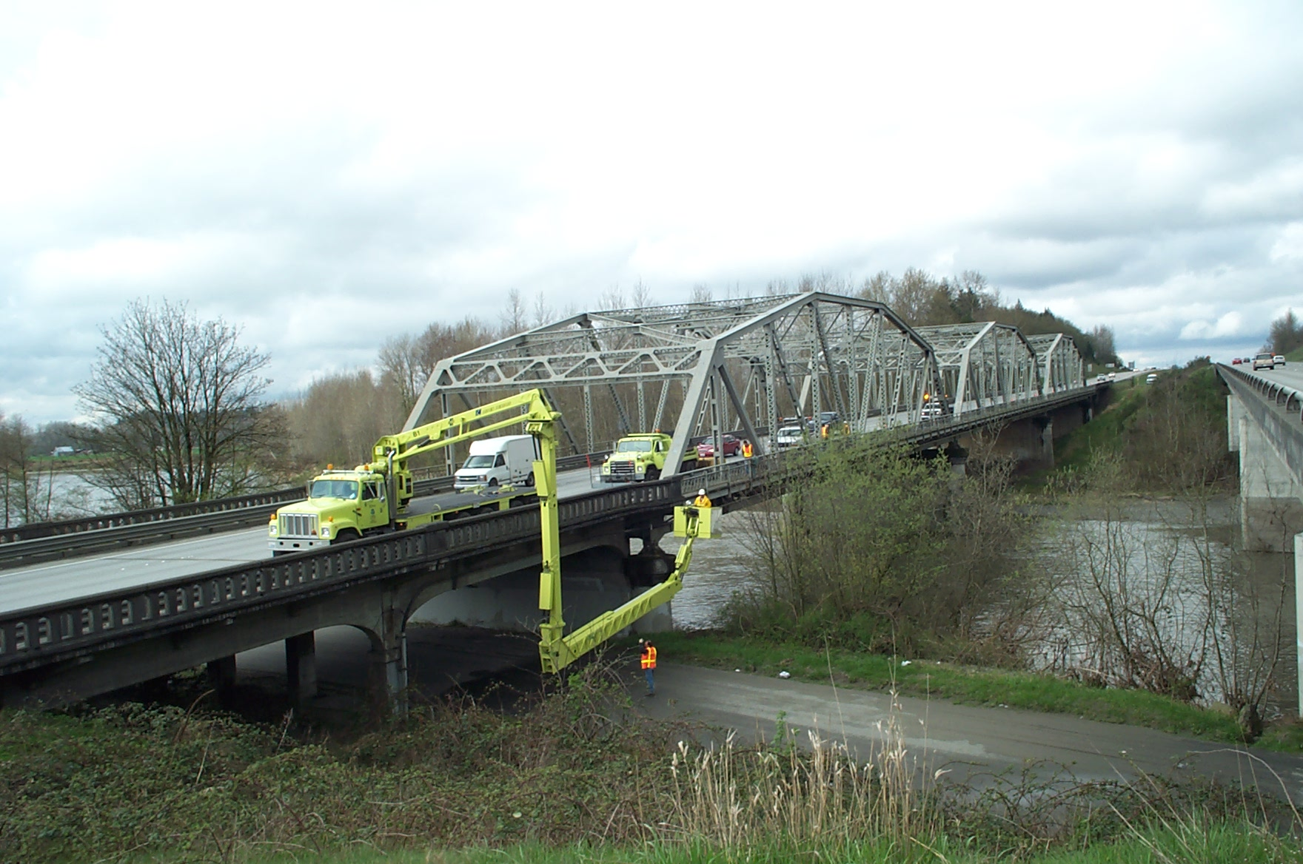
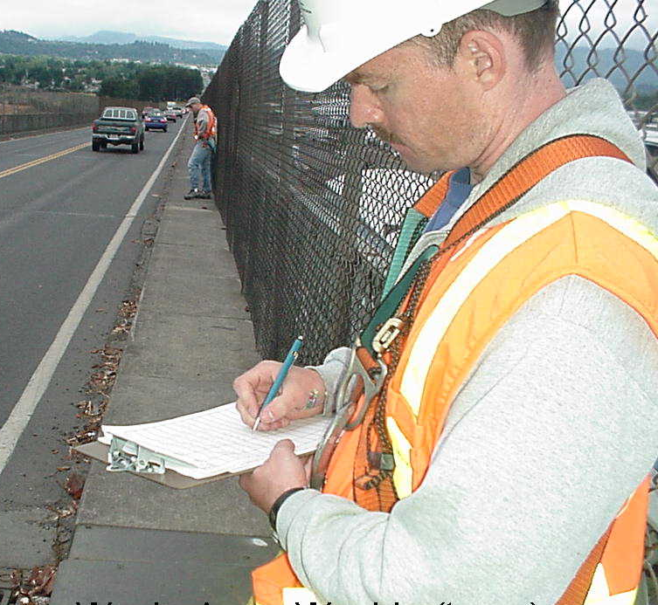
WSDOT’s Deck Evaluation Process
Inspect and Rate Deck Condition

Slide 16
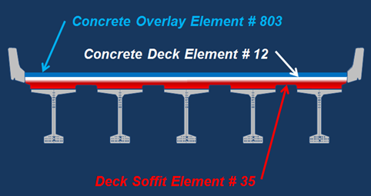
WSDOT Bridge Deck BMS Inspection

Slide 17
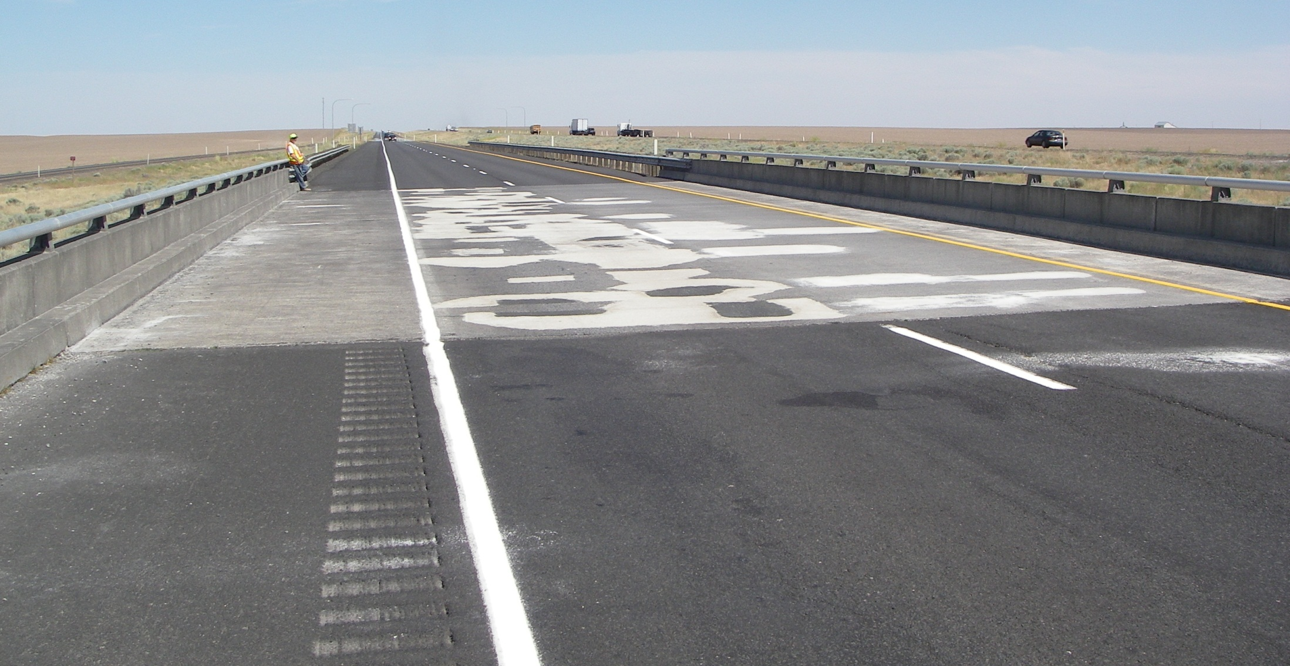
WSDOT Bridge Deck BMS Inspection
Condition State 1
The deck surface has no spalls/delaminations or previous repairs. May have cracking or rutting.
Condition State 2
The deck surface has previous repairs.
Condition State 3
The deck surface has spalling.
Condition State 4
Delamination Test Results.
90/316N Paha Rd OC - milepost 215.24
CS2- Patching (26%)
Year Built – 1972 (46 yrs)
Deck Thickness – 7”
Elem | Description | Total | Unit | State1 | State2 | State3 | State4
12 | Conc. Deck | 3,990 | SF | 2,774 | 1,053 | 0 | 163
35 | Soffit | 3,990 | SF | 3,990 | 0 | 0 | 0
376 | Delam Testing | 3,990 | SF | 3,827 | 0 | 0 | 163
2012
(4%)
Delam Test - October 2001

Slide 18
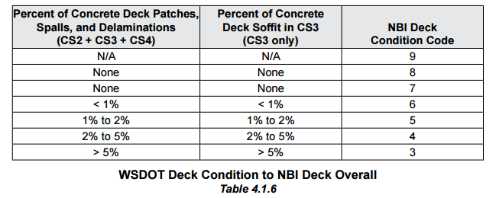
WSDOT Concrete Deck Evaluation/Rating
BMS Condition
(Top of Deck)
NBI Deck Code
Good
Fair
Poor

Slide 19
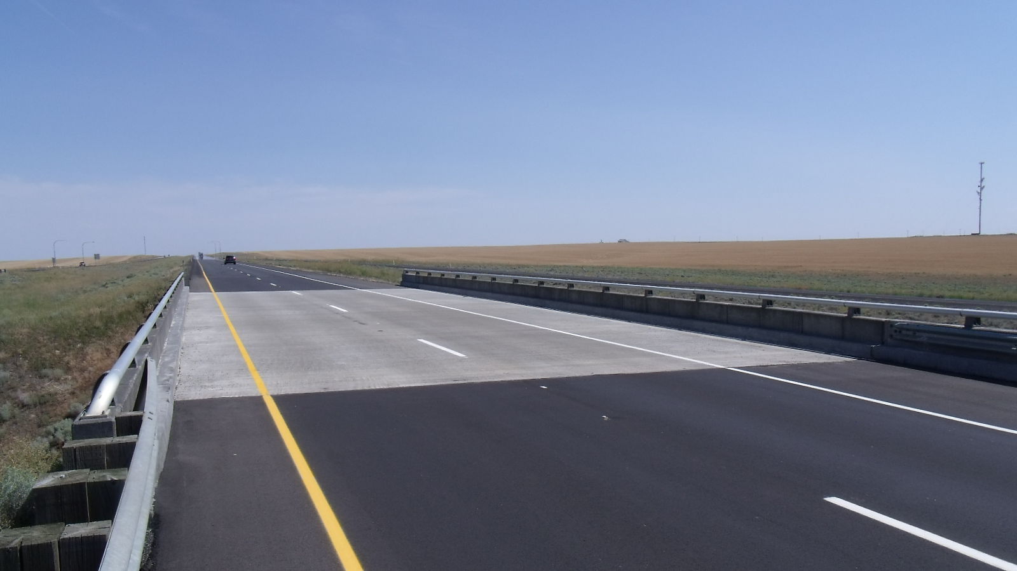
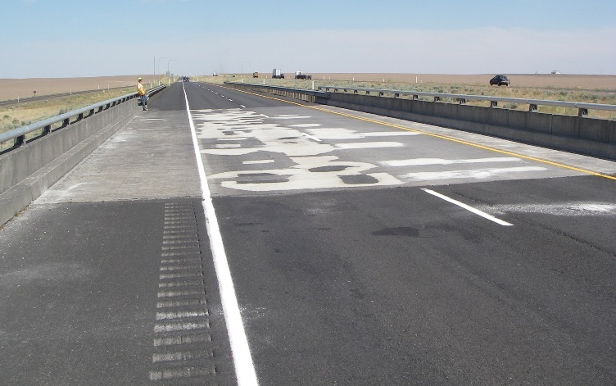
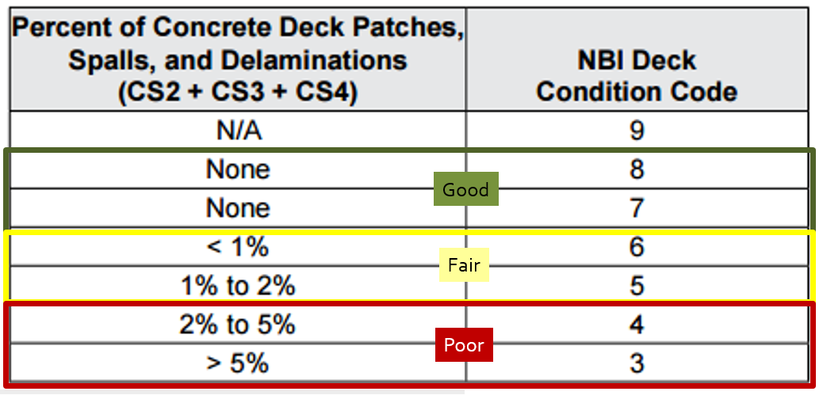

WSDOT Bridge Deck BMS Inspection
90/316N Paha Rd OC
90/316N Paha Rd OC - milepost 215.24
Modified Concrete Overlay
Applied 2013
Poor Condition
2012
Good Condition
Elem | Description | Total | Unit | State1 | State2 | State3 | State4
12 | Conc. Deck | 3,990 | SF | 2,774 | 0 | 0 | 0
35 | Soffit | 3,990 | SF | 3,990 | 0 | 0 | 0
376 | Delam Testing | 3,990 | SF | 3,827 | 0 | 0 | 0

Slide 20
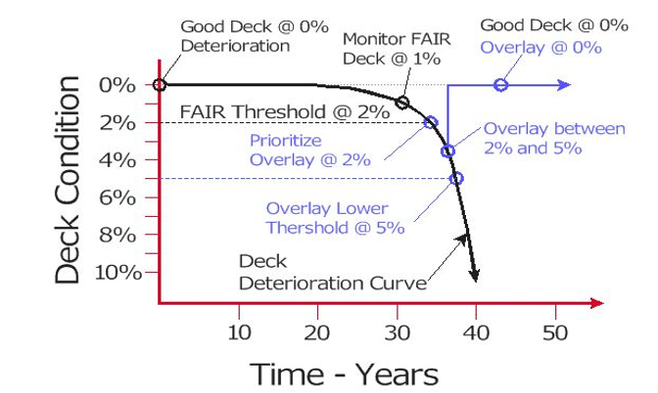
Good
Fair
Poor

Slide 21
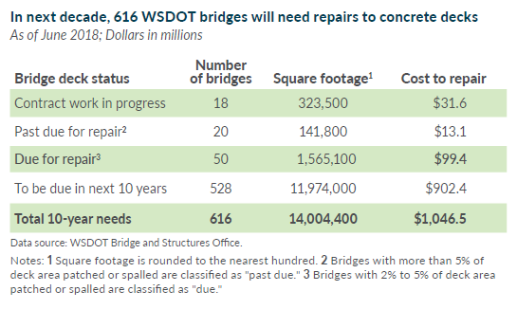
WSDOT Concrete Deck – 10 yr Preservation Needs
> 5%
2% - 5%
1% - 2%
Overlay 30+ yrs

Slide 22
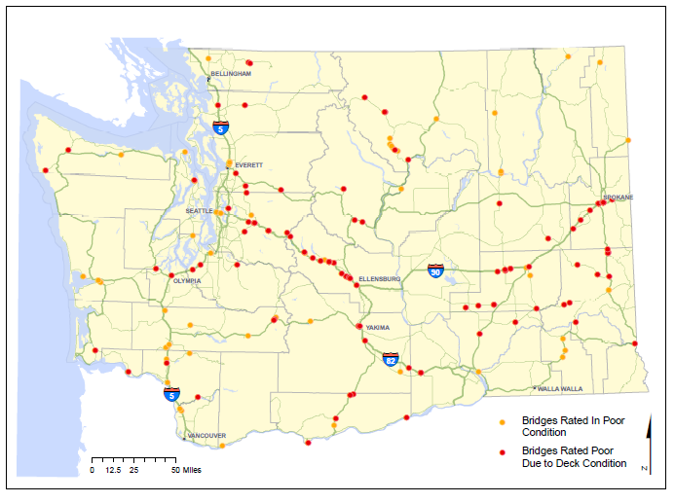

Slide 23
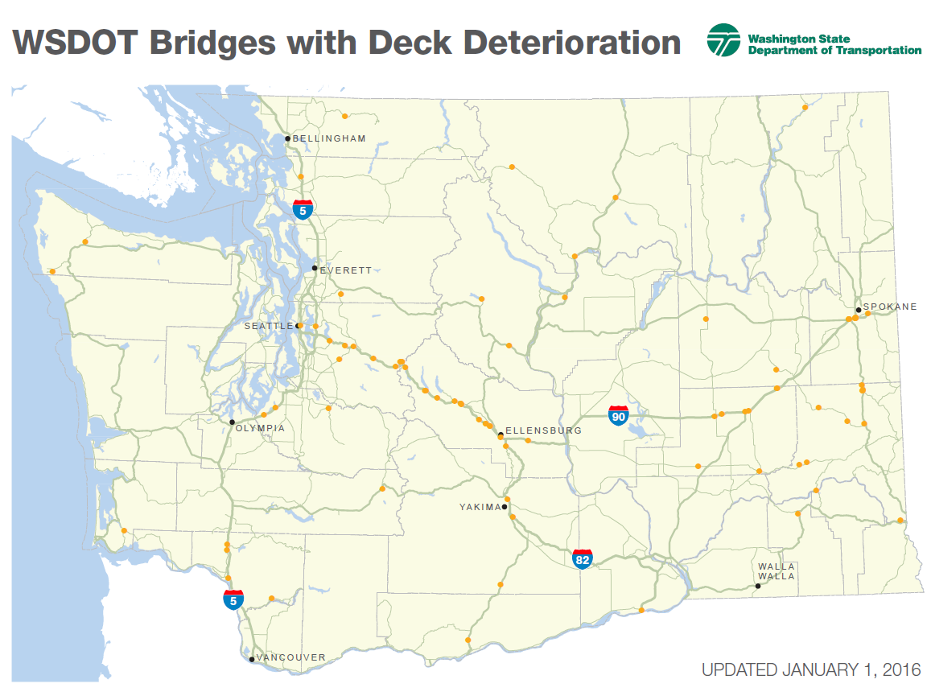
WSDOT Concrete Deck Rehab – 2018
2018 Planned Construction
14 bridges (225,175 SF)
US97 Okanogan R
97/534 – C9279
Mod Conc - 11,704SF
I-90 3rd Ave OC
290/1W-W – C9264
4,000D – 19,684 SF
I-90 Winery Rd
90/80S – C9213
Mod Conc - 7,020SF
I-90 2nd Ave OC
290/2W-W – C9264
4,000D – 6,346SF
I-90 Raging River
90/77N – C9213
Mod Conc – 20,436SF
I-90 Yakima R
90/140N & S – C9214
4,000D – 23,400SF
US195 RR OC
195/34 - C9204
4,000D – 6,080SF
US195
195/46 & 49 - C9204
4,000D – 19,685SF
I-90 Yakima R
90/154N & S – C9214
4,000D - 35,700SF
US195
195/52 & 60 - C9204
4,000D – 28,720SF
SR128 Snake R
128/10 - C9201
Mod Conc – 46,400SF

Slide 24
WSDOT Concrete Deck Rehab – 2019
2019 Planned Construction
5 bridges (55,665 SF)
SR302 Purdy Br
302/105 – Oct 2018
Polyester – 11,000SF
SR18 Holder Cr
18/31N – Oct 2018
4,000D – 12,251SF
I-90 Cle Elum R
90/134N & S – Jan 2019
4,000D – 17,582SF
I-5 Toutle R
5/140W – Apr 2018
Polyester – 14,832SF

Slide 25
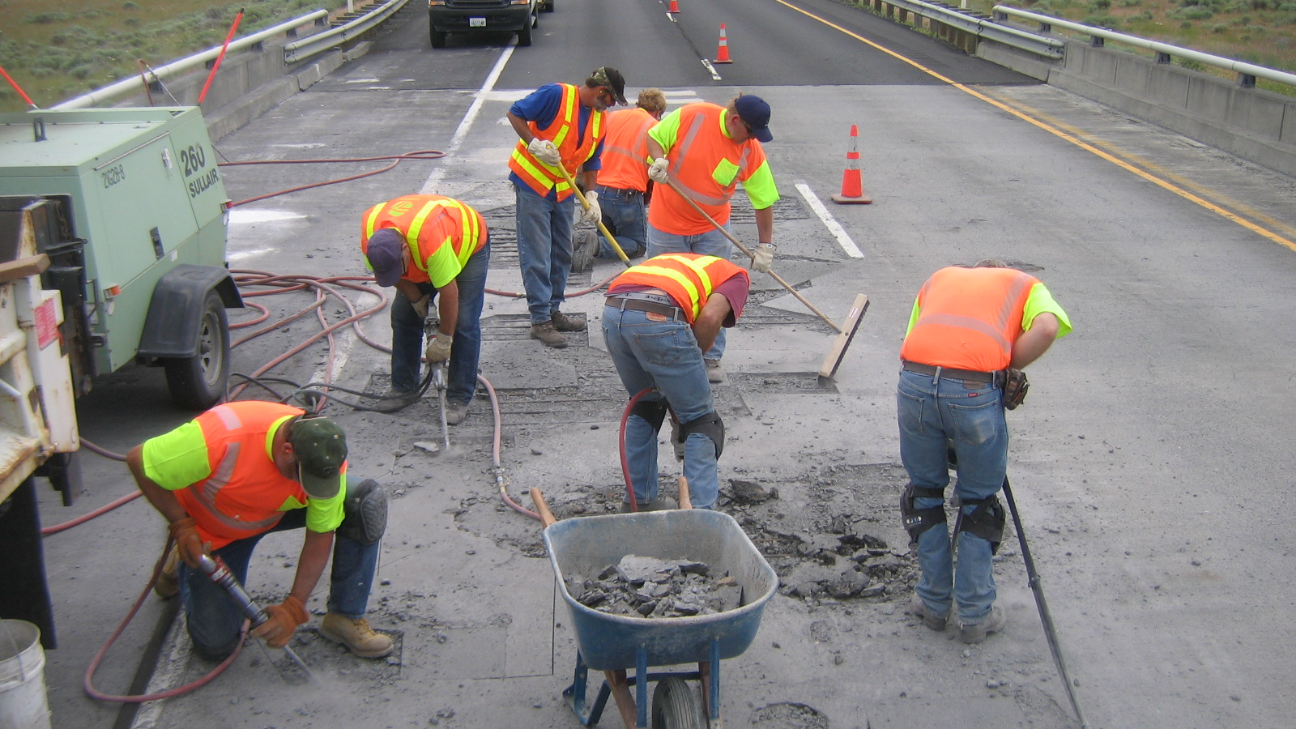
WSDOT Concrete Deck – 10 yr Preservation Needs
Bridge Deck Repair by WSDOT Maintenance Forces

Slide 26
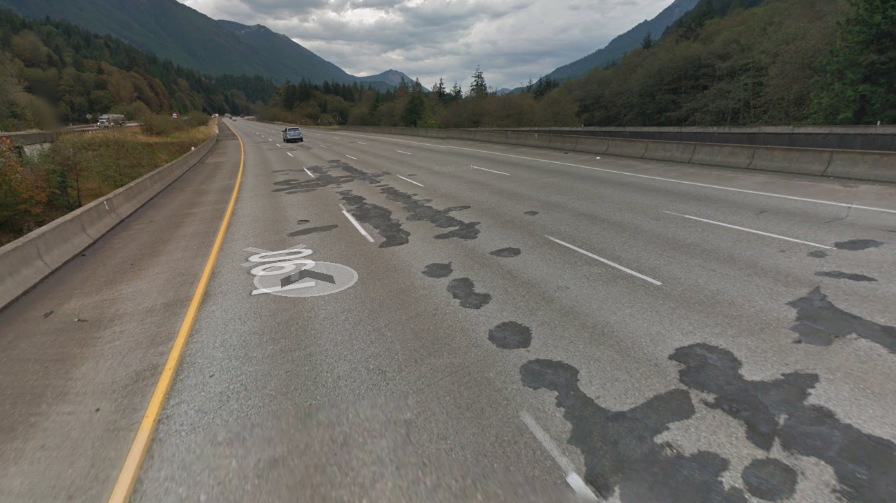
WSDOT Concrete Deck – 10 yr Preservation Needs
With constrained Funding for Deck Rehab
This is the new “Normal”

Slide 27
Washington State’s Concrete Bridge Deck Program
(2nd and 3rd Gen)
21
Built prior to 1980
3,039 Bridges with Concrete Decks
45.8 million SF deck area
564
792
14M SF
589
1030
13.2M SF
8.8M SF
8.5M SF
23
21
(19.3%)
(28.9%)
(30.8%)
(18.6%)
(1.6%)
(0.8%)

Slide 28
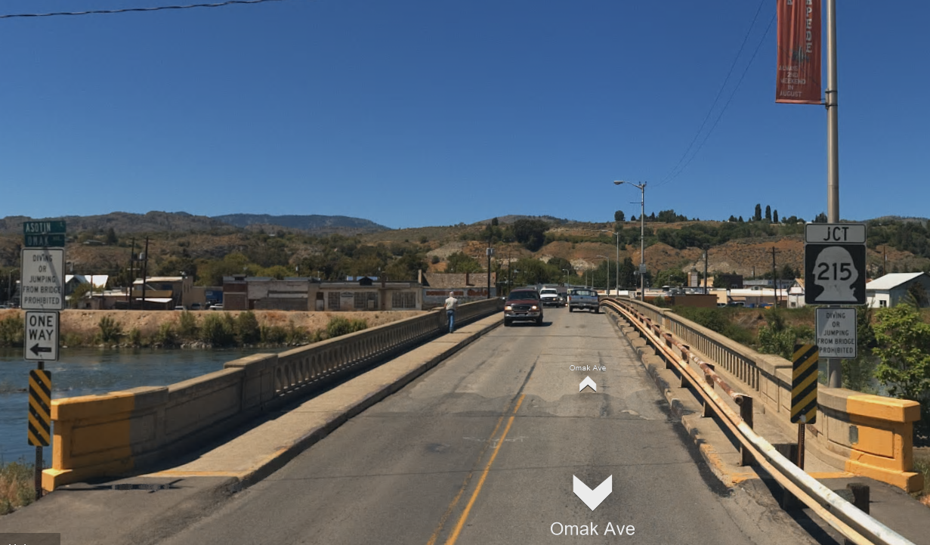
WSDOT Bare Concrete Decks
43 Bridges
1.0 M SF
(11.9%)
589 Bridges
8.8 M SF
Poor
Ave Age – 53yrs
Oldest – 95yrs
286 Bridges
5.3 M SF
(59.8%)
Good
Fair
25 bridges
> 75 yrs
259 Bridges
2.5 M SF
(28.3%)

Slide 29
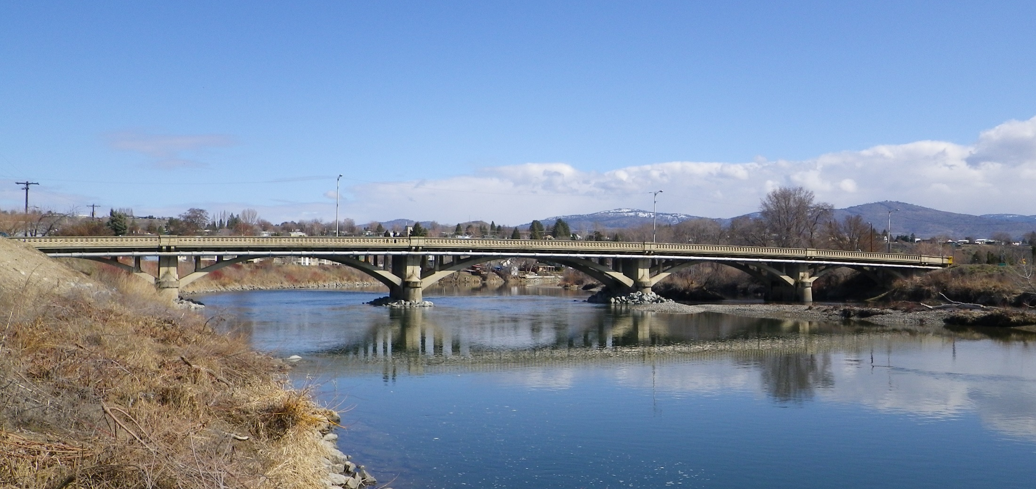
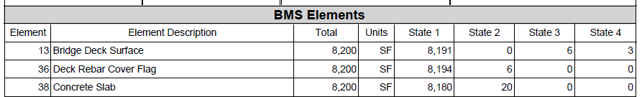
WSDOT Bare Concrete Decks
Year Built – 1923 (95 yrs)
Deck Thickness – 10”
Width 20 feet
SR155 – Okanogan River
Located in Omak
ADT – 6,884 / day
NBI Deck – 6
“Fair” Condition

Slide 30
Washington State’s Concrete Bridge Deck Program
(2nd and 3rd Gen)
21
3,039 Bridges with Concrete Decks
45.8 million SF deck area
Built after
1980
564
792
14M SF
589
1030
13.2M SF
8.8M SF
8.5M SF
23
21
(19.3%)
(28.9%)
(30.8%)
(18.6%)
(1.6%)
(0.8%)

Slide 31
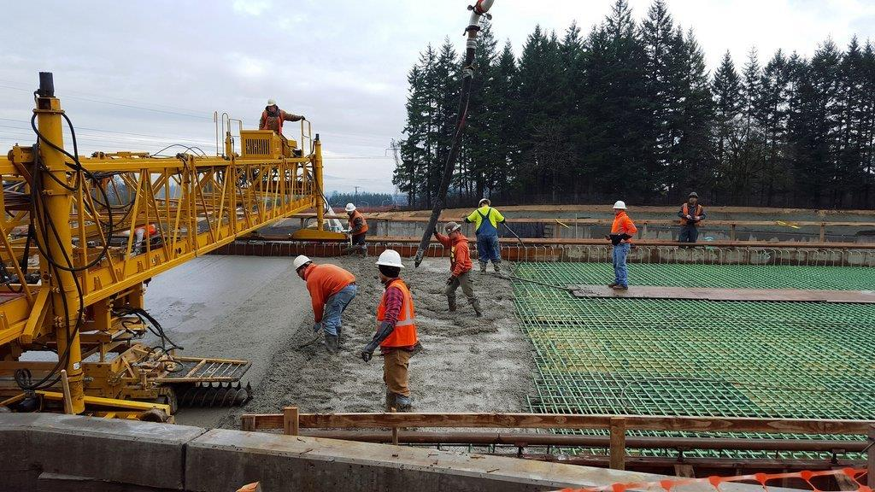
Concrete Decks with Epoxy Coated Rebar
Concrete Decks with Epoxy Coated Rebar
1910 - 80
1980 - 2007
2007 - present
Uncoated
Rebar
Top Mat
Coated
Both Mats
Coated
792 Bridges
13.2 M SF

Slide 32
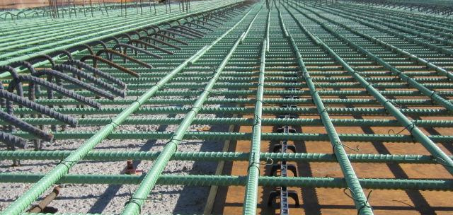
Concrete Decks with Epoxy Coated Rebar
792 Bridges
13.2 M SF
Ave Age – 22yrs
Oldest – 39yrs
84 Bridges
2.2 M SF
(16.6%)
Fair
Good
709 Bridges
11.0 M SF
(83.3%)

Slide 33
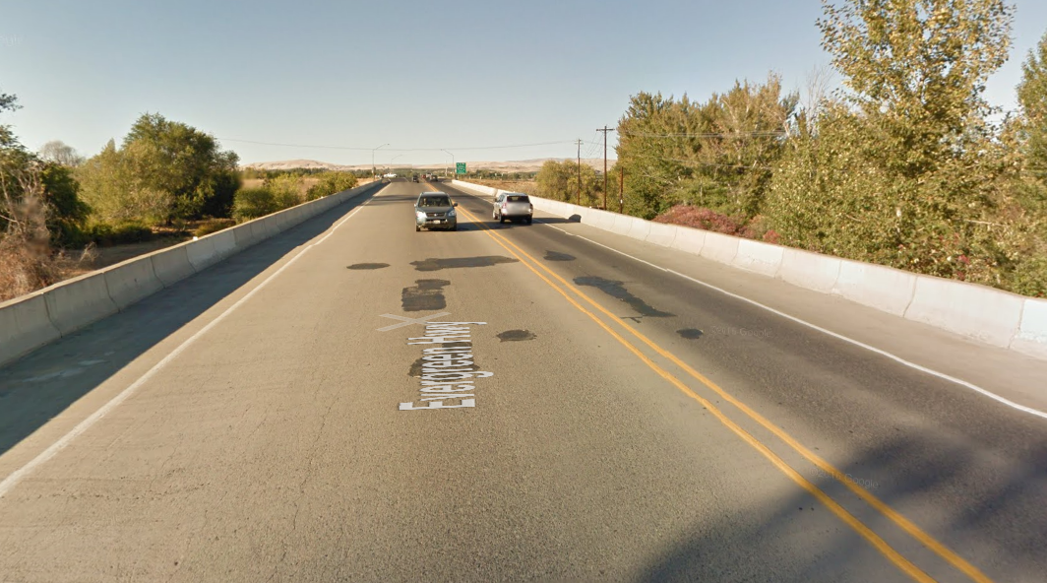
Concrete Decks with Epoxy Coated Rebar
Prestress Girder Bridge
Year Built – 1979 (39 yrs)
Deck Thickness – 7”
2” Cover – Top Mat
SR22 – Yakima River Overflow
Located near Toppenish, Wa
First Generation ECR
NBI Deck – 6
“Fair” Condition
271 SF Patching and spalls
(0.9%)

Slide 34
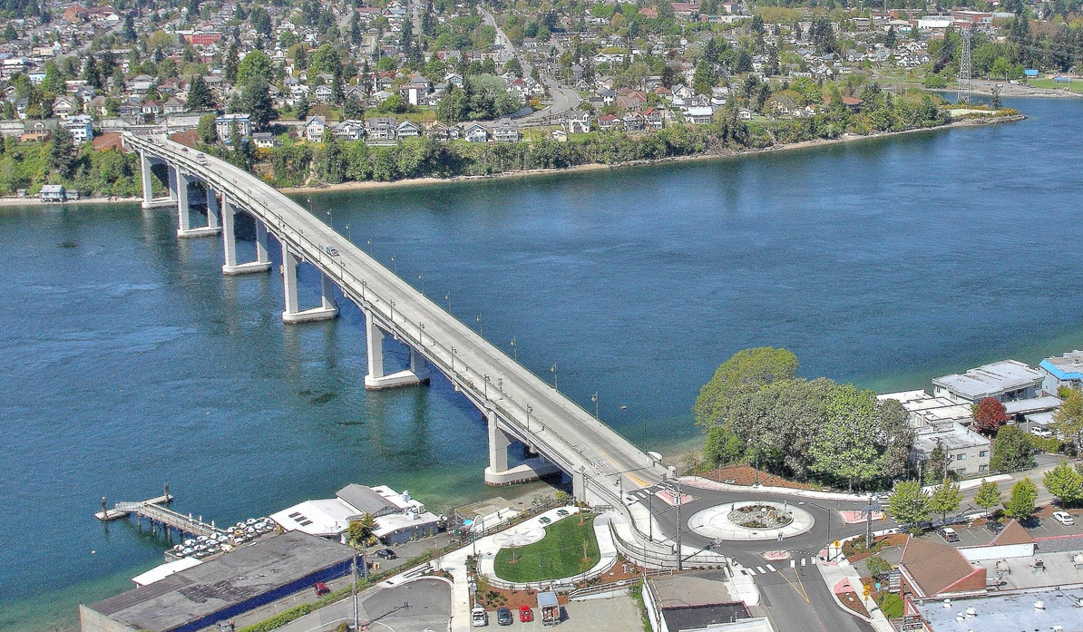
Concrete Decks with Epoxy Coated Rebar
SR303 Manette Bridge (Bremerton, Wa)
Length – 1,550’ (Max span of 250’)
Built in 2011

Slide 35
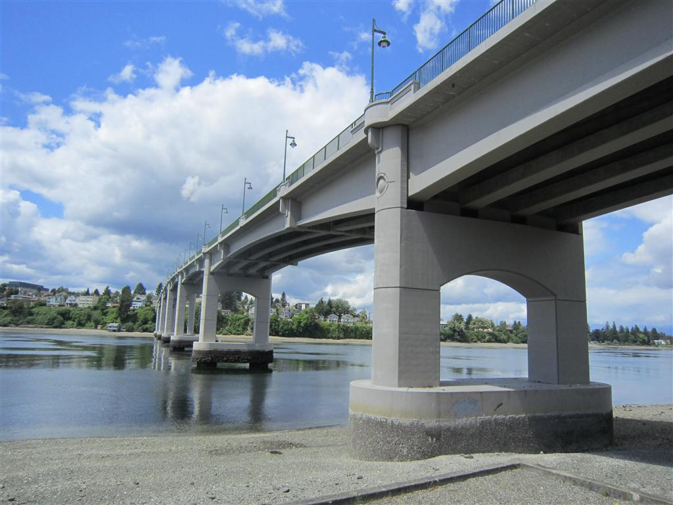
SR303 Manette Bridge (Bremerton, Wa)

Slide 36

Problem - WSDOT has observed abnormal cracking in many concrete bridge decks built between 2000 - 2013
SR303 Manette Bridge (Bremerton, Wa)
Built in 2011

Slide 37


Problem - WSDOT has observed abnormal cracking in many concrete bridge decks built between 2000 - 2013
SR303 Manette Bridge (Bremerton, Wa)
Built in 2011

Slide 38

SR303 Manette Bridge (Bremerton, Wa)
Maintenance Deck Seal trial section - 2016
Cost to seal entire deck about $200,000
Completed in 2018

Slide 39
Washington State’s Concrete Bridge Deck Program
(2nd and 3rd Gen)
21
3,039 Bridges with Concrete Decks
45.8 million SF deck area
564
792
14M SF
589
1030
13.2M SF
8.8M SF
8.5M SF
23
21
(19.3%)
(28.9%)
(30.8%)
(18.6%)
(1.6%)
(0.8%)

Slide 40
Bridges with a Modified Concrete Overlay
Latex
Fly-Ash
Microsilica
Low Slump
Rapid Set
LMC
1979
1983
1987
1995
2002-10
2016
2007 - present
1st Mod
Conc Overlay
Low Slump
Discontinued
1st Microsilica
Conc Overlay
1st Fly-Ash
Conc Overlay
Rapid Set
Discontinued
1st Perf Mix Design
Conc Overlay

Slide 41

Modified Concrete Overlays
Section 6-09
Choose between Latex/Microsilica/FlyAsh
Hydromill deck preparation
Overlay Concrete has typical 42hr cure
Diamond grind grooves
Special Provision
Performance mix (2nd generation)
7 day cure
Diamond grind grooves

Slide 42

Modified Concrete Overlays
584 Bridges
14.1M SF
44 Bridges
0.6M SF
(4.4%)
Ave Age – 26yrs
Oldest – 39yrs
183 Bridges
7.0M SF
(49.6%)
Good
Fair
187 bridges
(4.9M SF)
> 30 yrs
357 Bridges
6.5M SF
(46%)
Expected Service Life
25 – 30 years
Total Project Cost
$80 - $100 / SF

Slide 43


Modified Concrete Overlays
WSDOT 1st Mod Conc Overlay
“Good” Condition
US2 Pine Creek
1979

Slide 44

Modified Concrete Overlays
WSDOT 1st Mod Conc Overlay
US2 Pine Creek
Yr Built – 1949 (69yrs)

Slide 45
Modified Concrete Overlays
I-90 Denny Creek Bridge
Segmental Post-Tension Box
Standard rebar in Deck
Year Built – 1980 (38yrs)
LMC Overlay – 1980 (38yrs)
Deck – 10”
Length – 3,620 feet
Width – 52 feet
Repl Value - $200M

Slide 46

Modified Concrete Overlays
I-90 Denny Creek Bridge
52 Feet
curb - curb
Transverse Post Tensioning
3.5” below top of deck
15’
cantilever
16 Feet

Slide 47

Modified Concrete Overlays
I-90 Denny Creek Bridge
NBI Deck – 6
“Fair” Condition
Deck Patching / Spalls
1,871 SF (1.0%)

Slide 48

Modified Concrete Overlays
Bridge Deck Rehab
Hydromill and Concrete Overlay
2017
I-90 Denny Creek Bridge

Slide 49

Modified Concrete Overlays
Bridge Deck Rehab
Hydromill and Concrete Overlay
2017
I-90 Denny Creek Bridge

Slide 50

Modified Concrete Overlays
Bridge Deck Rehab
Hydromill and Concrete Overlay
2017
I-90 Denny Creek Bridge

Slide 51

Modified Concrete Overlays
I-90 Denny Creek Bridge

Slide 52
Washington State’s Concrete Bridge Deck Program
(2nd and 3rd Gen)
21
3,039 Bridges with Concrete Decks
45.8 million SF deck area
564
792
14M SF
589
1030
13.2M SF
8.8M SF
8.5M SF
23
21
(19.3%)
(28.9%)
(30.8%)
(18.6%)
(1.6%)
(0.8%)

Slide 53

Asphalt Paving Train

Slide 54






Paving Equipment Loads
Dump Truck: 40 Ton 3 axles
Planer: 45 Ton 2 tracks
Material Transfer: 70 Ton 2 axles
Paver: 40 Ton 1 track
Compactor: 15T+15T Vib. 2 axles
  Dump trucks and pup are legal loads.
  Paving Equipment does not have Legal Axles.
Posted bridges will limit operations.

Slide 55


Slide 56

Asphalt Removal – Tacoma Narrows Bridge
Older bridge
Built - 1949

Slide 57

Asphalt Removal – Tacoma Narrows Bridge
40k
40k
52k
40k
34k
52k
25 ft
25 ft
17 ft
50k
29k
29k

Slide 58

Asphalt Removal by Rotomill

Slide 59



Standard Rotary Mill Head
Asphalt Removal – Milling Machine
5/8” Planer Head Tooth Spacing.
Most common method used to remove asphalt.
New spec allows for Partial Removal only.
Edges will break off Typical Surface – 5/8” Spacing Replacing Teeth

Slide 60



Asphalt Removal – Milling Machine
Rotary milling has the risk of damaging the concrete deck.

Slide 61

Asphalt Removal - Scraping
Scraping with Loader, Grader, Bob Cat
Backhoe with a welded bar on the bucket
Scraping to remove ACP Required when:
Bridges over 100 feet in length
Bridges with integral bridge decks

Slide 62

Asphalt with Membrane Overlay
SR397 – Columbia R
Ed Hendler Bridge
Located near Pasco/Kennewick
1st Major Cable Stayed Bridge in USA
Open – Sept 1978 (40 yrs)
Length – 2,503 feet
Max Span – 981 feet
Deck Width – 60 feet
Original Cost - $30M
Replacement Cost - $120M+

Slide 63

SR397 – Columbia R
Ed Hendler Bridge
Located near Pasco/Kennewick

Slide 64

Asphalt with Membrane Overlay
Asphalt History
1978 - 1st ACP Overlay
1986 – Mill Fill 0.15’
1998 – New ACP w/Memb
2017 – New ACP w/Memb
SR397 – Columbia R
Ed Hendler Bridge
ADT – 16,129

Slide 65

Asphalt with Membrane Overlay
8” Top Deck
2” Conc Cover
Standard Rebar
SR397 – Columbia R
Ed Hendler Bridge
Each Segment is 27 x 80 feet
Weight - 300 tons

Slide 66

Asphalt with Membrane Overlay
SR397 – Columbia R
Ed Hendler Bridge
Scraping to remove Asphalt

Slide 67

Asphalt with Membrane Overlay
SR397 – Columbia R
Ed Hendler Bridge

Slide 68

Asphalt with Membrane Overlay
Applying Membrane
SR397 – Columbia R
Ed Hendler Bridge

Slide 69
Washington State’s Concrete Bridge Deck Program
(2nd and 3rd Gen)
21
3,039 Bridges with Concrete Decks
45.8 million SF deck area
564
792
14M SF
589
1030
13.2M SF
8.8M SF
8.5M SF
23
21
(19.3%)
(28.9%)
(30.8%)
(18.6%)
(1.6%)
(0.8%)

Slide 70

Polyester Concrete Overlays
3 Bridges
26.5K SF
(3.2%)
4 Bridges
533.5K SF
(63.7%)
23 Bridges
838K SF
Ave Age – 21yrs
Oldest – 29yrs
Good
Fair
8 bridges
> 25 yrs
16 Bridges
278K SF
(33.1%)
Expected Service Life
25+ years
Total Project Cost
$100 - $125 / SF

Slide 71

Polyester Concrete Overlays
ADT – 90,000
Bridge Built – 1966
Polyester applied - 2007
I-5 NB Viaduct
Located in Seattle

Slide 72

Polyester Concrete Overlays
Interstate 90
2017

Slide 73
Washington State’s Concrete Bridge Deck Program
(2nd and 3rd Gen)
21
3,039 Bridges with Concrete Decks
45.8 million SF deck area
564
792
14M SF
589
1030
13.2M SF
8.8M SF
8.5M SF
23
21
(19.3%)
(28.9%)
(30.8%)
(18.6%)
(1.6%)
(0.8%)

Slide 74

Thin Polymer Overlays
US101 Chehalis River Bridge

Slide 75
Summary of WSDOT Bridge Deck Rehabilitation Options
Deck Protection | Criteria for use
Epoxy Coated Rebar | All New Bridges
Asphalt / Membrane | Exist Asphalt / Deck in Good Cond
Modified Conc Overlay | Br Decks with > 2% Patching
Polyester Overlay | Br Decks with < 2% Patching
Polymer Overlay | Movable Bridges

Slide 76
WSDOT’s Concrete Bridge Deck
Preservation Program
How do we Measure Success?

Slide 77

WSDOT Bridge Deck Replacements
Br Num | Yr | Length
395/40 | 1986 | 2,451
12/512N | 1987 | 1,270
82/280S | 1988 | 1,471
395/16 | 1988 | 72
240/32W | 1989 | 244
281/1 | 1990 | 196
9/130 | 1991 | 344
529/10E | 1994 | 1,544
397/10 | 1995 | 261
509/101 | 1995 | 562
509/103 | 1995 | 264
433/1 | 2004 | 5,478
97/1 | 2009 | 2,567
10/143 | 2012 | 430
5/670W | 2014 | 859
82/280S | 2018 | 1,920
16 bridges (588,536 sq ft) [1.5% of total Statewide Deck Area]

Slide 78

WSDOT Br Deck Preservation Savings
Epoxy Coated Rebar - $1/SF
ACP w/membr - $20/SF
Conc Overlay - $80/SF
Polyester Overlay - $120/SF
Replace Deck - $250/SF
Replace Bridge - $800/SF
14M SF / 2 x $170/SF = $1.2 Billion Savings (over 35 yrs)

Slide 79

WSDOT’s Concrete Bridge Deck Preservation Program
Questions?

