Slide 1
Welcome to the Life Cycle Assessment (LCA) Learning Module Series
Liv Haselbach Quinn Langfitt
Narrated by Sila Temizel-Sekeryan
For current modules email lhaselbach@lamar.edu or visit cem.uaf.edu/CESTiCC or https://engineering.lamar.edu/civil/faculty/haselbach/research.html
Acknowledgements:
CESTiCC Washington State and LAmar Universitıes

Slide 2
LCA Module Series Groups
Group A: ISO Compliant LCA Overview Modules
Group α: ISO Compliant LCA Detailed Modules
Group B: Environmental Impact Categories Overview Modules
Group β: Environmental Impact Categories Detailed Modules
Group G: General LCA Tools Overview Modules
Group γ: General LCA Tools Detailed Modules
Group T: Transportation-Related LCA Overview Modules
Group τ: Transportation-Related LCA Detailed Modules

Slide 3
Resource-Based and Other Impact Categories
It is suggested to review Modules B1 and B3 prior to this module.
Module β8

Slide 4
Introduction
LCA tracks the extractions from and emissions to nature (Simonen 2014).
Difference between ‘impact on …’ and ‘use of …’ needs to be clarified.
The categories covered in modules Beta 1-7 are for impacts
This module summarizes some of the other categories common in LCA which are for use
Resource depletion
Water use
Energy use
Land use
Developing categories for impacts
Odor and noise
Indoor air
Radiation

Slide 5
Resource Depletion
Biotic
Abiotic
Natural resources which come from recently living feedstock
Generally “renewable”, but not always
Examples:
Natural wood
Fish from the sea
Animals from nature
Does not include agricultural products (i.e. crops, farm animals, grown wood).
Natural resources which are non-living
(and have not been recently living)
Generally “non-renewable”, but not always
Examples:
Iron ore
Crude oil
Sand
Water
Air
Sometimes fossil fuels and water get own categories separate from resource depletion
Note: Definition of “renewable” can be ambiguous. On what time scale, by what processes, with what percent recovery for a resource to be considered renewable?
Notes:
Example of abiotic that might be considered renewable is iron ore, since it can be re-extracted and recycled
Example of biotic that might be considered non-renewable is a tropical rainforest since once destroyed it will not be likely to come back
Biotic only include things that are living due to natural systems, and so exclude crops, cows, chickens, etc.

Slide 6
Example Characterizations of Resource Depletion
ADP= Σ_{i} (m_{i} x ADP_{i})
where
ADP= Abiotic resource depletion in kg antimony-eq
m_{i} = mass (in kg) of inventory flow i,
ADP_{i} = kg of antimony that would be used to have the same effect on antimony depletion that the inventory flow has on depletion of that resource
Method 1: Ratio of use in product system to known reserves compared to antimony
Method 2: Ratio of use in product system to years until exhaustion based on current use rate of material, compared to the same indicator for antimony
BDP= Σ_{i} (m_{i} x BDP_{i})
where
BDP= Biotic resource depletion in kg reference substance
m_{i} = mass (in kg) of inventory flow i,
BDP_{i} = kg of reference that would be used to have the same effect on depletion that the inventory flow has on depletion of the inventory resource
Similar to Method 2, except also a term for how rapidly the resource is being added through new growth as part of determining time until expected exhaustion
Notes:
Make clear that this is assuming that abiotic are not regenerative and biotic are.

Slide 7
Renewability of Abiotic/Biotic Resources
Some abiotic resources are renewable on small timescales
One example is sand
Might be used for building materials
May be renewed by erosion in nature
For further information refer to Materials and the Environment by Michael F. Ashby
Some biotic resources are renewable only on larger timescales
One example is old growth forests

Slide 8
Water Use
LCA usually only deals with fresh water (not salt water)
Can you really “use” water?
Yes, in some applications (like electrolysis)
In others it goes back into water cycle
But sometimes with contaminants
For degradative use, not specifically analyzing contaminant effects
Rather, reduction of available freshwater reserves
Usually just an inventory of water use
Sometimes related to available reserves in area like done for abiotic and biotic resources
e.g. Pfister et al. 2009
Typical midpoint: Depletion of water
Typical endpoint: Less water available for use by humans and animals
consumptive use
regenerative use
degradative use
Pfister, S., Koehler, A., & Hellweg, S. (2009). Assessing the environmental impacts of freshwater consumption in LCA. Environmental science & technology, 43(11), 4098-4104.
Notes:
Contaminant effects already covered in ecotoxicity, eutrophication, etc.

Slide 9
Consideration of Variability in Types of Water Use
Regenerative e.g. cooled cooling water
May not deplete reserves
Consumptive e.g. cement to concrete
Likely to deplete reserves, but what source?
Degradative e.g. process water
Might contaminate more water than being “used”
Groundwater? Surface water?
Might be returned not significantly affected
Notes:
As presented on the previous slide, different “uses” of water might be very different…. some applications might not actually deplete water at all…. Each of these types of water use are very different and so the way the water is being used can significantly alter its actual effects on water availability. An ideal inventory would include this type of information so that the analyst could better classify whether or not certain uses should be included. This is one area that might be prime for the interpretation reporting phase of LCA since these differences might be significant, and warrant discussion, but a water use indicator might not separate them.

Slide 10
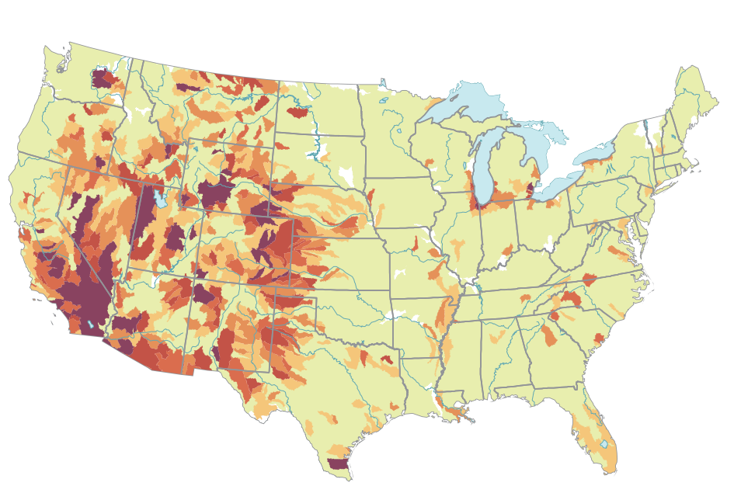
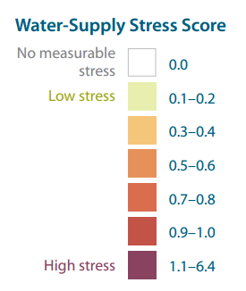
Water Use Regional Variability
Impacts vary by region
More issue in areas with more demand and less supply
Source of water should be tracked in an LCI if possible
Could be captured with regional factors
Figure source: Averyt, K., et al. 2011. Freshwater use by U.S. power plants: Electricity’s thirst for a precious resource. A report of the Energy and Water in a Warming World initiative. Cambridge, MA
Notes:
Really only makes sense to assess fresh water use on a regional basis since it is not traded world-wide and issues of water availability vary so widely between regions.

Slide 11
Definitions of Energy Use
Embodied Energy
Energy Demand
Energy Content

Slide 12
Embodied Energy
Energy used (blue) to produce Product A
(Sometimes disposal energy is included)
Natural Gas
Coal
Wind
Crude oil
Natural Gas
Coal
Solar
Electricity
Gasoline
Lube oil
Electricity
Production of Product A
Use of Product A
Disposal of Product A
Natural Gas

Slide 13
Energy Demand
All energy inputs to the entire product life cycle
Natural Gas
Coal
Wind
Crude oil
Natural Gas
Coal
Solar
Electricity
Gasoline
Lube oil
Electricity
Production of Product A
Use of Product A
Disposal of Product A
Natural Gas

Slide 14
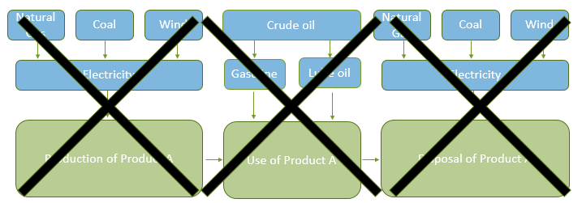
Energy Content – Feedstock Energy
Total energy output when the material is combusted
Product A
(e.g wooden beam, newspaper, fireworks, ethanol, etc.)

Slide 15
Energy Use – System Boundary Lingo
Fossil Energy
Renewable Energy
Cumulative Energy Demand
Secondary Energy Demand
Net Energy Balance
Notes:
And although I will be showing the example using whole life energy demand, the same indicators could also be used with embodied energy where the example would then be with only the production or production and disposal processes.

Slide 16
Fossil Energy
Just the energy used that came from fossil fuels, in terms of the energy content of those fuels used
Natural Gas
Coal
Wind
Crude oil
Natural Gas
Coal
Solar
Electricity
Gasoline
Lube oil
Electricity
Production of Product A
Use of Product A
Disposal of Product A
Natural Gas

Slide 17
Renewable Energy
Energy from renewable sources
Biomass
Coal
Wind
Crude oil
Natural Gas
Coal
Solar
Electricity
Gasoline
Lube oil
Electricity
Production of Product A
Use of Product A
Disposal of Product A
Natural Gas

Slide 18
Cumulative Energy Demand
Total energy used for the product over the life cycle in terms of energy content of sources
Natural Gas
Coal
Wind
Crude oil
Natural Gas
Coal
Solar
Electricity
Gasoline
Lube oil
Electricity
Production of Product A
Use of Product A
Disposal of Product A
Natural Gas

Slide 19
Secondary Energy
Energy input directly to the product
(not included: fuel energy content wasted rather than converted to energy for making/using/disposing of product)
Natural Gas
Coal
Wind
Crude oil
Natural Gas
Coal
Solar
Electricity
Gasoline
Lube oil
Electricity
Production of Product A
Use of Product A
Disposal of Product A
Natural Gas

Slide 20
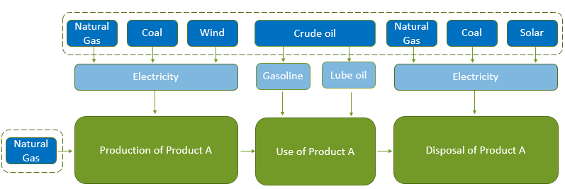
Net Energy Balance
Cumulative energy demand minus the energy content of the product
Only makes sense for a product intended to be used for its energy content
Product A
(e.g charcoal or ethanol)
Notes:
The moral of the story is that “energy use” can mean a lot of things and when carrying out or interpreting a study, be careful that you know what type of energy use and what system boundary was used so you can actually understand how much and what types of energy went into the product.

Slide 21
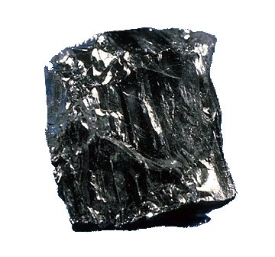
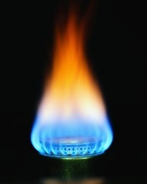
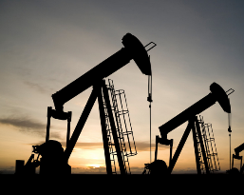
Fossil Fuel Use
Subcategory of abiotic resource depletion and/or energy use
At highest level fossil fuels include coal, natural gas, and crude oil
Could be simple such as MJ of fossil fuel consumed (inventory)
Could be based on how much of each type of fossil fuel is consumed with weighting
In TRACI weighted by the expected increase in energy needed to extract that type of fuel in the future
Or weighted by current rate of use versus reserves
Coal: Wikipedia.org Natural gas: psc.wi.gov Oil: atozforex.com
Notes:
This is similar to the already covered fossil energy indicator, but is included separately here because sometimes it is it’s own impact category, and it may be dealt with as an abiotic resource instead of or in addition to an energy indicator.
In TRACI explained as, for example, we have a lot of coal and it’s not getting that much harder to extract so it might get a relatively low characterization factor. But the more crude oil we extract, it starts getting a lot more energy intensive to recover new reserves (like shale oil and tar sands) so that gets a higher characterization factor.

Slide 22
Land Use
Competition
Land as a “resource”
Transformation
Loss of biodiversity
Loss of life support
m² used
species density
net primary production
Notes:
Loss of biodiversity means that fewer species exist there. Loss of life support means that the species that are there do not grow as much. Net primary production specifically refers the net carbon flux into green plants per time.

Slide 23
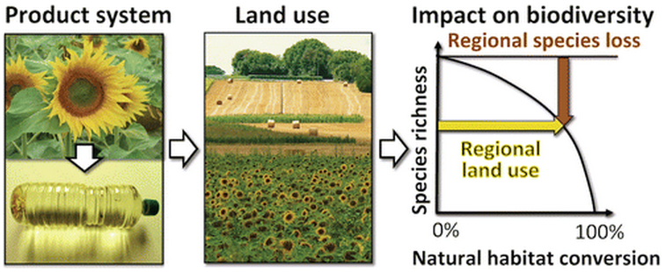
Land Use - Transformation
Related issues include resource depletion, soil quality, and biodiversity (Mattila et al. 2012)
Resource depletion: Occupied land weighted by the productivity index of that land
Soil quality: Difference in time-integrated soil organic carbon between the studied land and woodlands as a reference
Biodiversity: Correlations of land cover and endangerment of animals and plants
Only significant changes to land use should probably be considered in LCA (Bare et al. 2002)
Previous versus new use
Degree of transformation
Occupation duration
Expected recovery time
Image: de Baan et al. 2013. “Land use in LCA: Global Characterization Factors Based on Regional and Global Potential Species Extinction.” Env. Sci. & Tech. 47(16).
Notes:
Previous versus new
One proxy solution implemented in TRACI is based on threatened and endangered species
Degree of transformation
e.g. one crop to another, probably not significant
natural forest to cropland, probably significant
Duration and recovery time
If only temporarily being used, how quickly can the ecosystem be restored or restore itself

Slide 24
Odor and Noise
Neither included in most impact methodologies as of now
Only should be considered for a study where smells/noise are of particular concern at some point in the product life cycle
Odor could be characterized using “odor threshold values” (OTVs) relative to that of a reference as the characterization value
OTV is subjective judgment by panel at what concentration an odor can be detected
Noise could be characterized by “disturbed human hours”
Endpoints could be communication disturbance during the day and sleep disturbance during the night
Suggestions for characterization from Klopffer and Grahl 2014 Nose: Huffpost.com Ear: drtanase.com

Slide 25
Thank you for completing Module β8!
Group A: ISO Compliant LCA Overview Modules
Group α: ISO Compliant LCA Detailed Modules
Group B: Environmental Impact Categories Overview Modules
Group β: Environmental Impact Categories Detailed Modules
Group G: General LCA Tools Overview Modules
Group γ: General LCA Tools Detailed Modules
Group T: Transportation-Related LCA Overview Modules
Group τ: Transportation-Related LCA Detailed Modules

Slide 26
Additional Sources for Further Study
ASTM (2008). ASTM E2114-08, Standard Terminology for Sustainability Relative to the Performance of Buildings, ASTM International, West Conshohocken, PA.
ASTM (2015). ASTM E1705-15, Standard Terminology Relating to Biotechnology, ASTM International, West Conshohocken, PA.
Athena Institute (2014). User Manual and Transparency Document Impact Estimator for Buildings v.5, Athena Sustainable Materials Institute, Ontario, Canada.
BS EN (2012). BS EN 15804:2012 − Sustainability of Construction Works - Environmental Product Declarations - Core Rules for the Product Category of Construction Products, British Standards, London, United Kingdom.
EC (2010). ILCD Handbook (International Reference Life Cycle Data System): Analysis of existing Environmental Impact Assessment methodologies for use in Life Cycle Assessment, European Commission, Joint Research Centre, Institute for Environment and Sustainability, Luxembourg.
Guinée et al. (2001a). LCA - An operational guide to the ISO-standards - Part 2a: Guide, Universiteit Leiden, Institute of Environmental Sciences (CML), Leiden, Netherlands.
Guinée et al. (2001b). LCA - An operational guide to the ISO-standards - Part 3: Scientific background, Universiteit Leiden, Institute of Environmental Sciences (CML), Leiden, Netherlands.
ISO (2007). ISO 21930:2007 − Sustainability in building construction – Environmental declaration of building products, International Organization for Standardization, Geneva, Switzerland.

Slide 27
Suggestions for Assignments
Is the reporting of energy use consistent among sectors? You may consider paving, construction, roofing, wood, flooring, plastics and agricultural fertilizer industries for this question. You may also check applicable standardizations from ISO, BS EN and ASTM. Give examples if you find different reporting approaches.
Examine different life cycle impact assessment methodologies (CML, TRACI, EDIP, RECIPE etc.) and find out how they measure and handle resource depletion (both abiotic and biotic), water use, energy use, land use, odor and noise, indoor air, and radiation categories.

Slide 28
References
Averyt, K., et al. 2011. Freshwater use by U.S. power plants: Electricity’s thirst for a precious resource. A report of the Energy and Water in a Warming World initiative. Cambridge, MA
Baan et al. 2013. “Land use in LCA: Global Characterization Factors Based on Regional and Global Potential Species Extinction.” Env. Sci. & Tech. 47(16).
Bare, J. C. 2002. “Traci.” Journal of Industrial Ecology 6 (3–4): 49–78.
Haselbach, L. (2017). Critical Review of LCA Treatment of Feedstock Energy, National Asphalt Pavement Association (NAPA). [https://www.lamar.edu/engineering/civil/faculty/haselbach/documents/napa-final-report.pdf]
ISO (2006). ISO 14040:2006 − Environmental management - Life cycle assessment - Principles and framework, International Organization for Standardization, Geneva, Switzerland.
Klöpffer, W., and Grahl, B. 2014. Life Cycle Assessment (LCA). Wiley, Weinheim, Germany.
Mattila, T., Lehtoranta, S., Sokka, L., Melanen, M., Nissinen, A. 2012. “Methodological Aspects of Applying Life Cycle Assessment to Industrial Symbioses.” Journal of Industrial Ecology 16 (1): 51–60.
Michael F. Ashby. 2013. Materials and the Environment. Elsevier, Oxford, UK.
Pfister, S., Koehler, A., Hellweg, S. 2009. Assessing the environmental impacts of freshwater consumption in LCA. Environmental science & technology, 43(11), 4098-4104.
Simonen, K. (2014). Life Cycle Assessment. Routledge, New York, NY.

