Slide 1

Welcome to the Life Cycle Assessment (LCA) Learning Module Series
Liv Haselbach Quinn Langfitt
For current modules email haselbach@wsu.edu or visit cem.uaf.edu/CESTiCC
Acknowledgements:
CESTiCC Washington State University Fulbright

Slide 2
LCA Module Series Groups
Group A: ISO Compliant LCA Overview Modules
Group α: ISO Compliant LCA Detailed Modules
Group B: Environmental Impact Categories Overview Modules
Group β: Environmental Impact Categories Detailed Modules
Group G: General LCA Tools Overview Modules
Group γ: General LCA Tools Detailed Modules
Group T: Transportation-Related LCA Overview Modules
Group τ: Transportation-Related LCA Detailed Modules

Slide 3
Building LCA Software Tutorial (BIRDS, BEES)
Module γ2

Slide 4

Building Industry Reporting and Design for Sustainability (BIRDS v1)
For environmental and economic analysis of new commercial buildings
  Operating energy
  Environmental performance of materials, construction, and use
  Life-cycle cost
Online-based tool
Produced by NIST in the US
Simple input in three steps (output options in fourth step)
  Select building
  Select comparisons
  Select environmental preferences
Available at: birdscom.nist.gov
Logo: birdscom.nist.gov

Slide 5
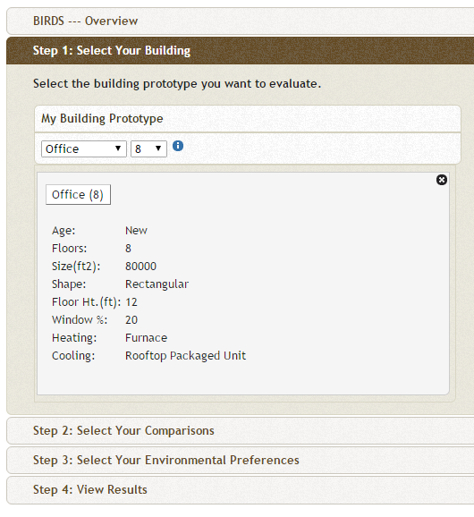

BIRDS (Step 1)
Building types include
  Apartment
  Dormitory
  Hotel
  Office
  Restaurant
  Retail Store
  High School
For each various number of floors available
Click to open detailed information as shown

Slide 6
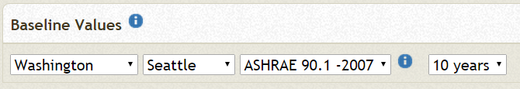
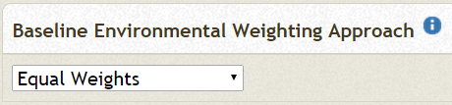
Baselines
In Steps 2 and 3 baselines must be selected including
  Building location
  Building energy standard
  Study period
  Impact category weighting scheme
In Step 4, will choose which to make comparisons along
Only one can be used as the basis of comparison at a time
All others will take value of base case

Slide 7
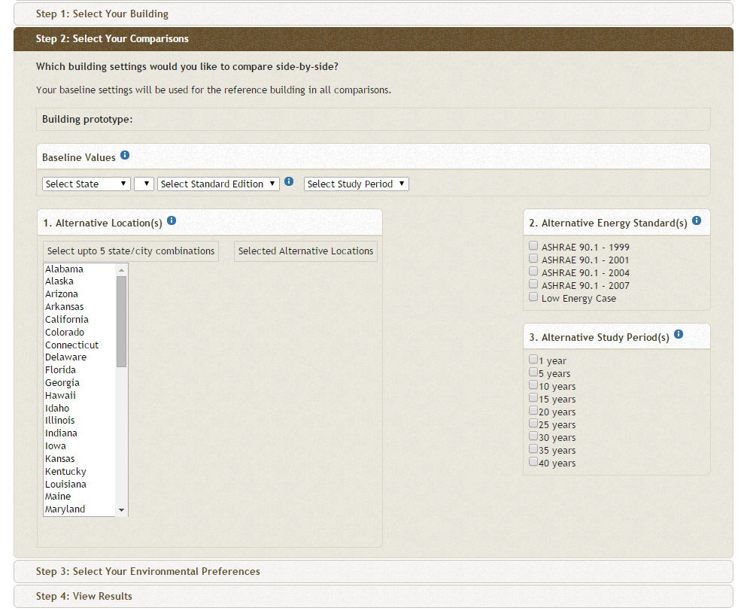
BIRDS (Step 2)
Choose baseline value
  State
  City
  ASHRAE Edition
  Time period (1-40 years)
Can choose alternatives to compare to
  Same selections as baseline
ASHRAE 90.1
  Energy Standard for Buildings Except
  Low-Rise Residential Buildings
  Prescriptive or performance based
  Often used as municipal/state standard
  or part of standards
ASHRAE 189.1-2009

Slide 8
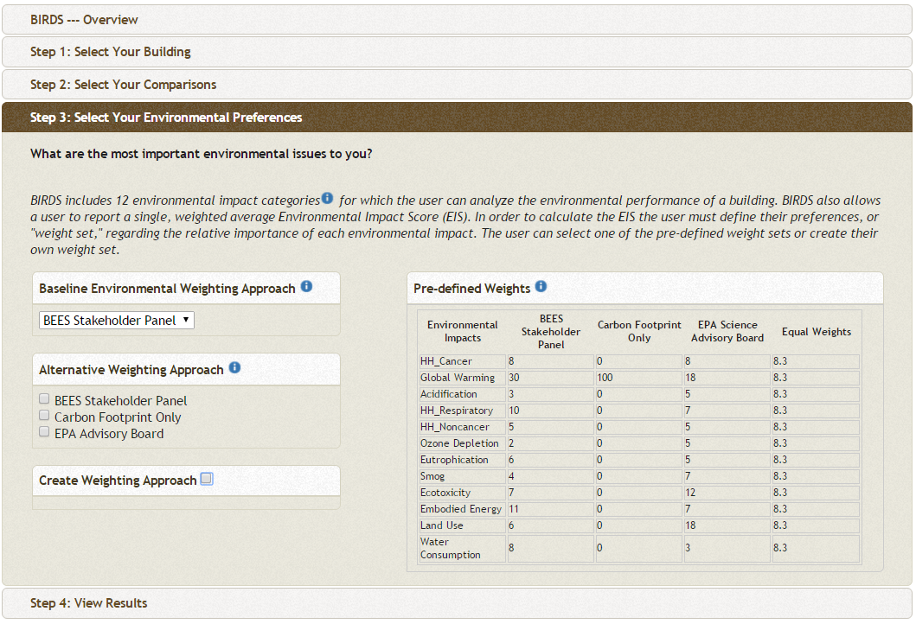
BIRDS (Step 3)
12 impact categories
Choose weighting scheme
  BEES Stakeholder Panel
  EPA Advisory Board
  Carbon Footprint Only
  Equal Weights
  Custom Weights
This baseline and alternatives is not referring to baseline/ alternatives chosen in Step 2
  Just alternative weighting schemes to apply to all cases
Click by Pre-defined Weights to see how schemes are developed

Slide 9
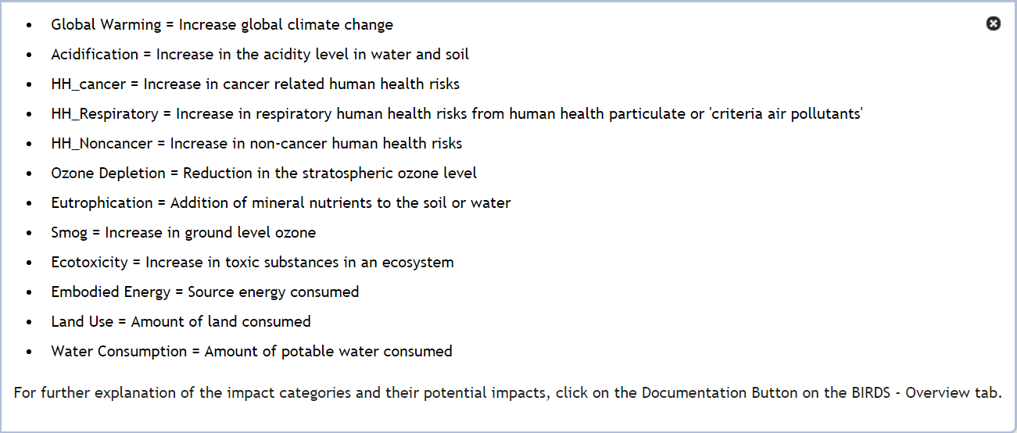
BIRDS (Step 3)

Slide 10
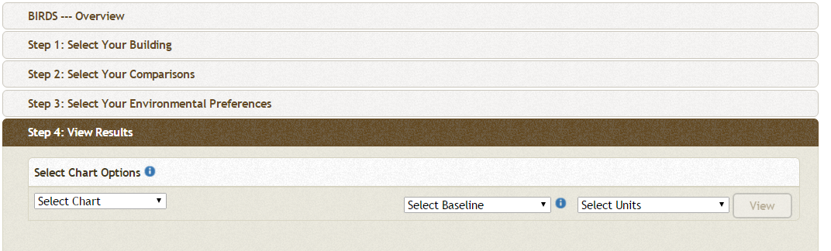
BIRDS (Step 4)
Choose type of results
  Life-cycle cost
  Operating energy
  Environmental impact
Choose one dimension as comparison basis
  Building location
  Building energy standard
  Study period
  Impact category weighting scheme
Indictor unit
  kg eq substance
  kg eq substance/ft²
  change in each

Slide 11
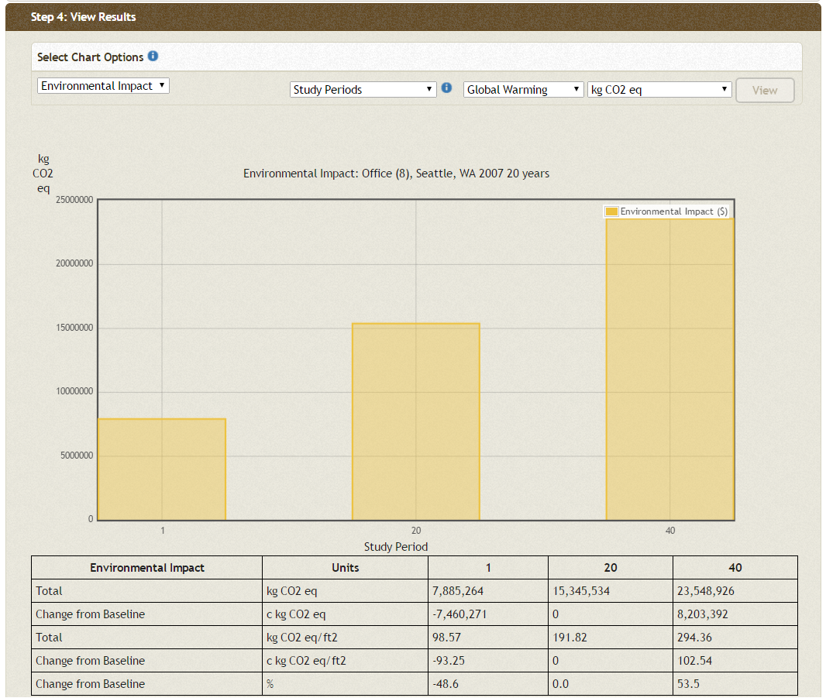
BIRDS Results
Study Period
Global Warming kg CO2-eq
Shows total impact (not yearly)
Divide by study period for yearly impact
Shows only selected unit on chart
  All units in table below

Slide 12
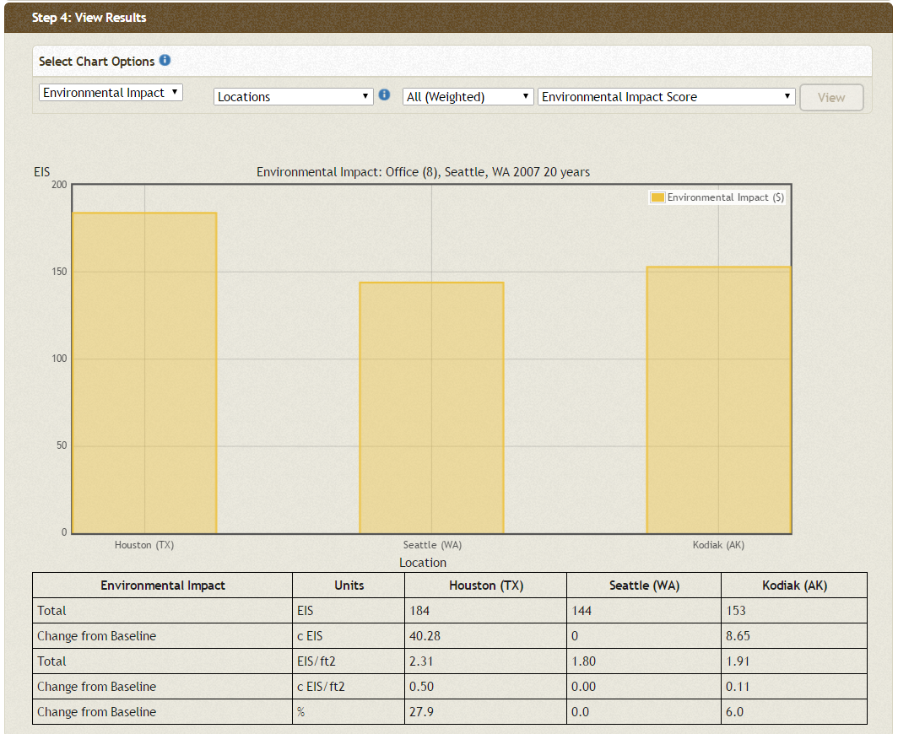
BIRDS Results
Locations
All (Weighted)
Env. Impact Score

Slide 13
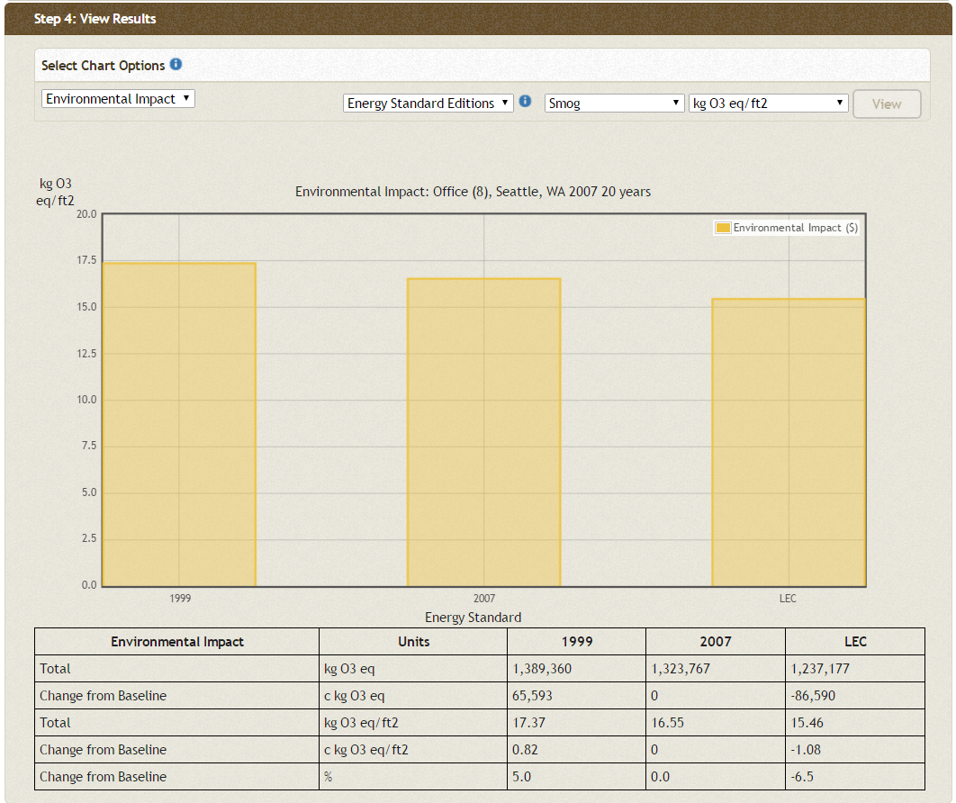
BIRDS Results
Energy Edition
Smog kg O₃-eq/ft²

Slide 14

Building for Environmental and Economic Sustainability (BEES)
Predecessor to BIRDS
For environmental and economic
analysis of building products
Online-based tool
Produced by NIST in the US
Analyze individual building products (rather than whole building)
Nearly 200 products included
  Concrete, roofing, insulation, water distribution piping, cleaning materials, paving, more
Simple to use
  Most data and processes set, just choose weighting scheme, product(s) of interest, and transport distance
Link to BEES online

Slide 15
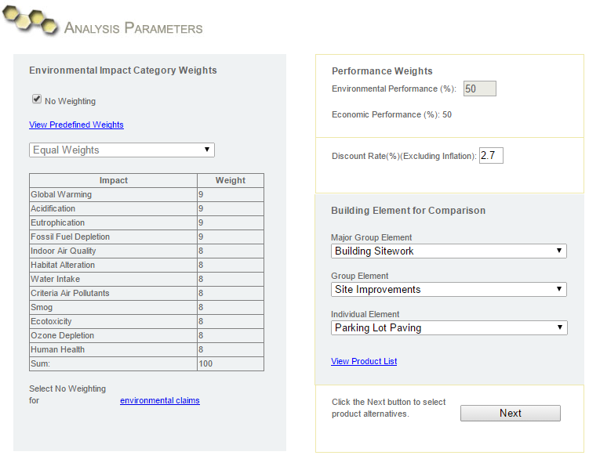
BEES Analysis
Parameters

Slide 16
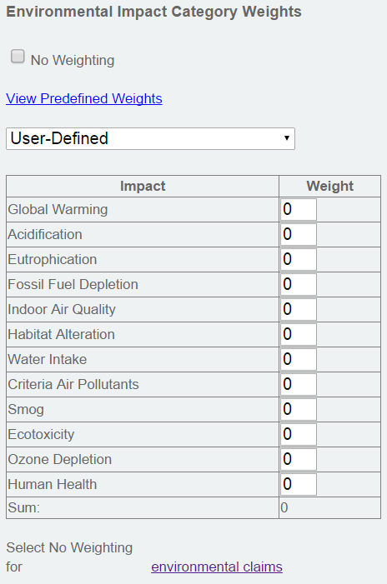
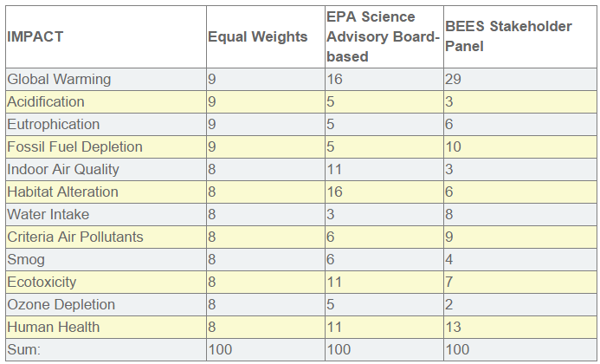
Environmental Weighting Scheme

Slide 17
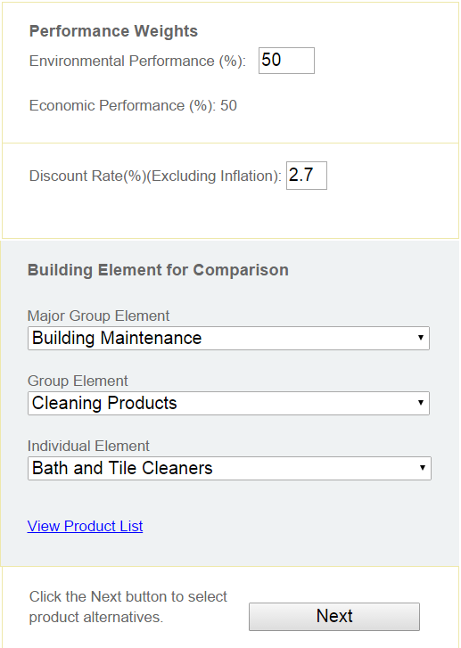
Performance weights
BEES can output a “score” in addition to impact category indicators
This weights importance of environment and economics in scores
For environmental analysis alone, enter 100
Discount rate deals with time value of money (does not affect environmental)
  1 dollar invested today might be worth 2 dollars in 10 years

Slide 18
Element Selection
Major group elements include
  Building Maintenance
  Building Repair & Remodeling
  Building Sitework
  Domestic Water Distribution
  Equipment & Furnishings
  Interiors
  Sanitary Waste
  Services
  Shell
  Substructure
All products in one list

Slide 19
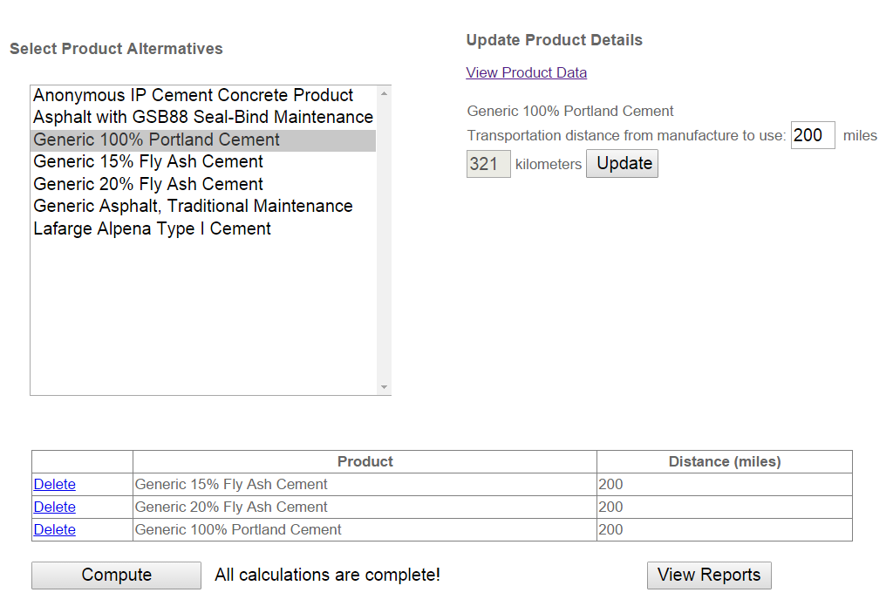
Product Selection
Inventory results by life cycle stage
Only appears after clicking compute

Slide 20
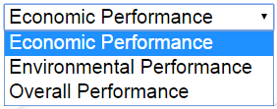
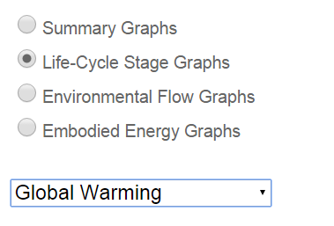
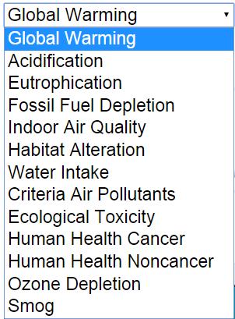

Output Type Selection

Slide 21
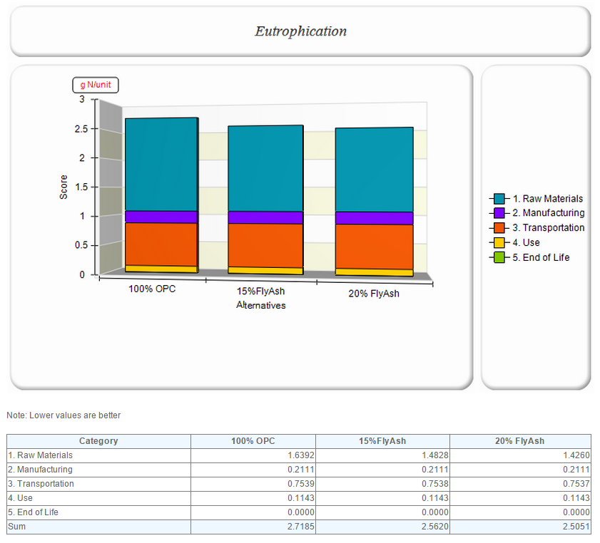
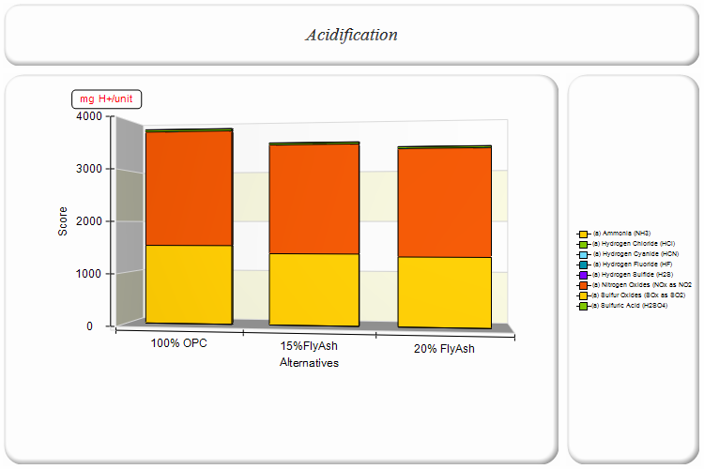
BEES Output
By life cycle stage
By environmental flow

Slide 22
Thank you for completing Module γ2!
Group A: ISO Compliant LCA Overview Modules
Group α: ISO Compliant LCA Detailed Modules
Group B: Environmental Impact Categories Overview Modules
Group β: Environmental Impact Categories Detailed Modules
Group G: General LCA Tools Overview Modules
Group γ: General LCA Tools Detailed Modules
Group T: Transportation-Related LCA Overview Modules
Group τ: Transportation-Related LCA Detailed Modules

