Slide 1

Welcome to the Life Cycle Assessment (LCA) Learning Module Series
Liv Haselbach Quinn Langfitt
For current modules email haselbach@wsu.edu or visit cem.uaf.edu/CESTiCC
Acknowledgements:
CESTiCC Washington State University Fulbright

Slide 2
LCA Module Series Groups
Group A: ISO Compliant LCA Overview Modules
Group α: ISO Compliant LCA Detailed Modules
Group B: Environmental Impact Categories Overview Modules
Group β: Environmental Impact Categories Detailed Modules
Group G: General LCA Tools Overview Modules
Group γ: General LCA Tools Detailed Modules
Group T: Transportation-Related LCA Overview Modules
Group τ: Transportation-Related LCA Detailed Modules

Slide 3
Athena Impact Estimator for Highways
Module τ4

Slide 4

IE for Highways
Athena Impact Estimator for Highways
Free, download-based tool
Analyzing initial paving materials, highway use, maintenance, end-of-life using LCA
Currently only for Canadian Provinces
Designed to make LCA of pavement more accessible to transportation engineers and pavement designers
Based on fairly simple inputs on roadway parameters, materials, distance of transport, energy use, etc.
  Can alter more detailed inputs for more control or leave with the default recommended values
Mostly based on national averages, with some regional data for distances and electrical grid
Download from Website
  http://www.athenasmi.org/our-software-data/impact-estimator-for-highways/
Logo source: athenasmi.org

Slide 5
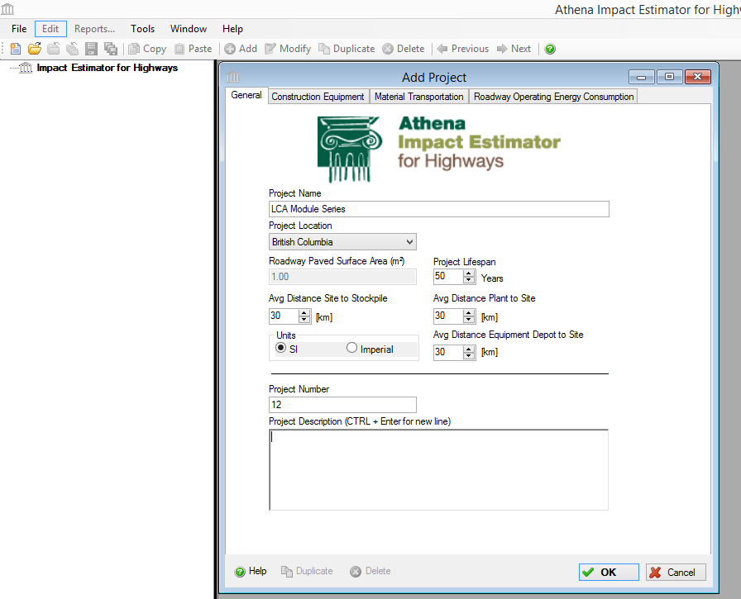
Starting a New
Project
More tabs across the top
Construction equipment
  Edit the equipment used for roadway construction
  Fuel consumption
  Production rates
  Load factor
  Working time per day
Material Transportation
  Modes of material transport
  Distances of transport

Slide 6
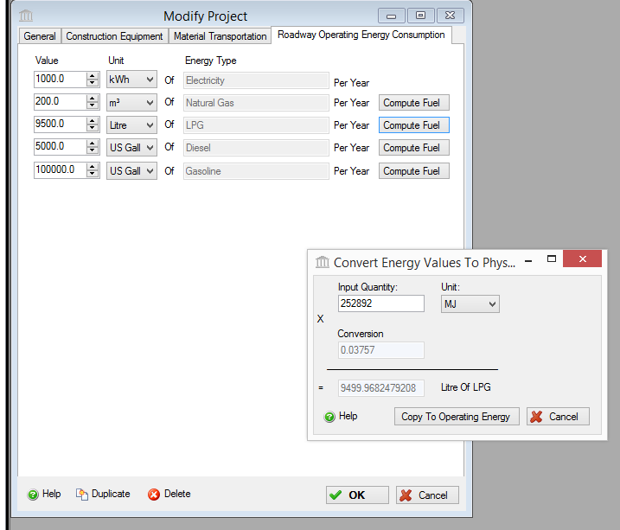
Roadway
Operating
Energy
Consumption

Slide 7
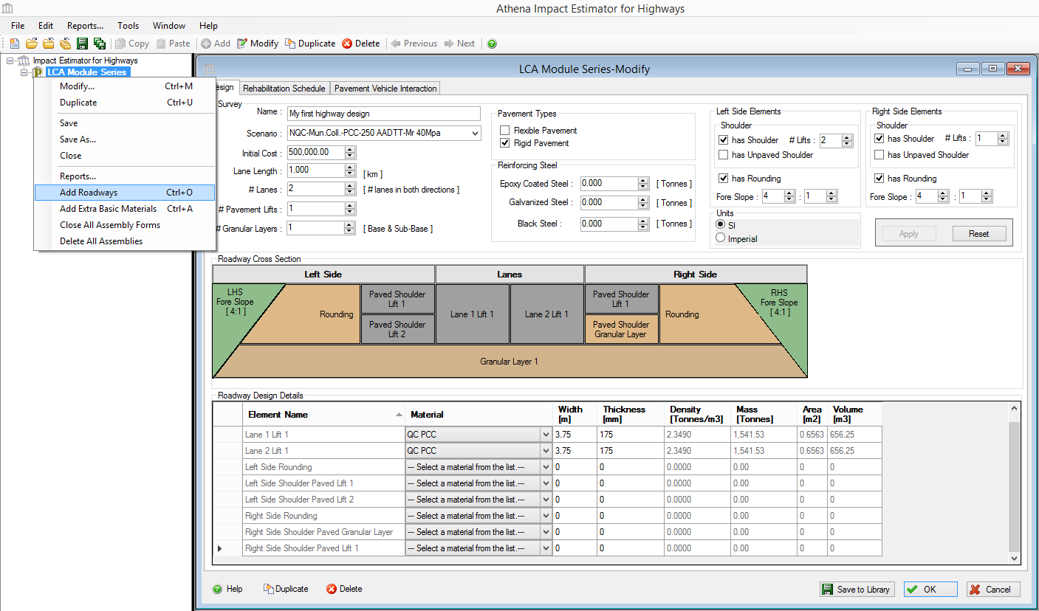
Add
Road-
Way

Slide 8
Overall Roadway Design and Dimensions

Slide 9
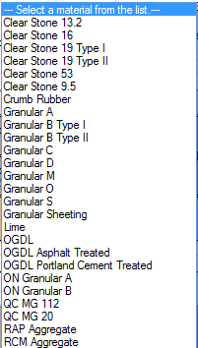
Roadway Materials Selection

Slide 10
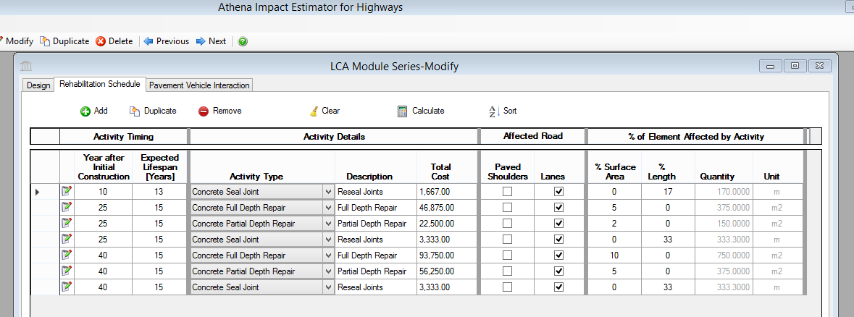
Rehabilitation Schedule

Slide 11
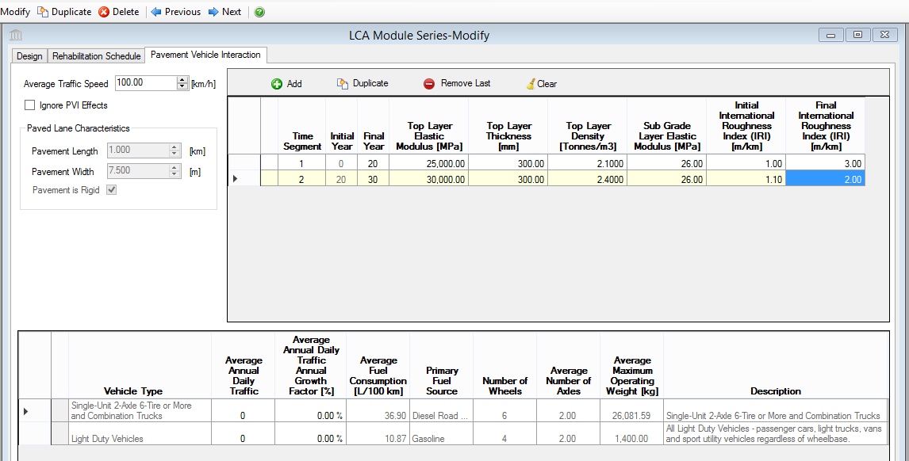
Pavement-Vehicle Interaction
Uses MIT’s
“PVI
Mechanistic
Model Gen II”

Slide 12
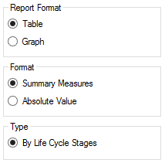
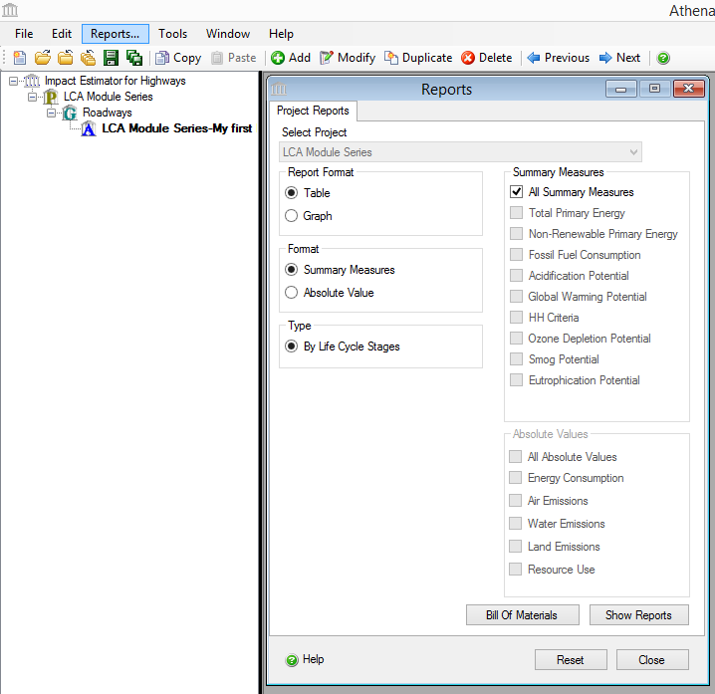
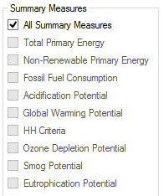
Calculating Results

Slide 13
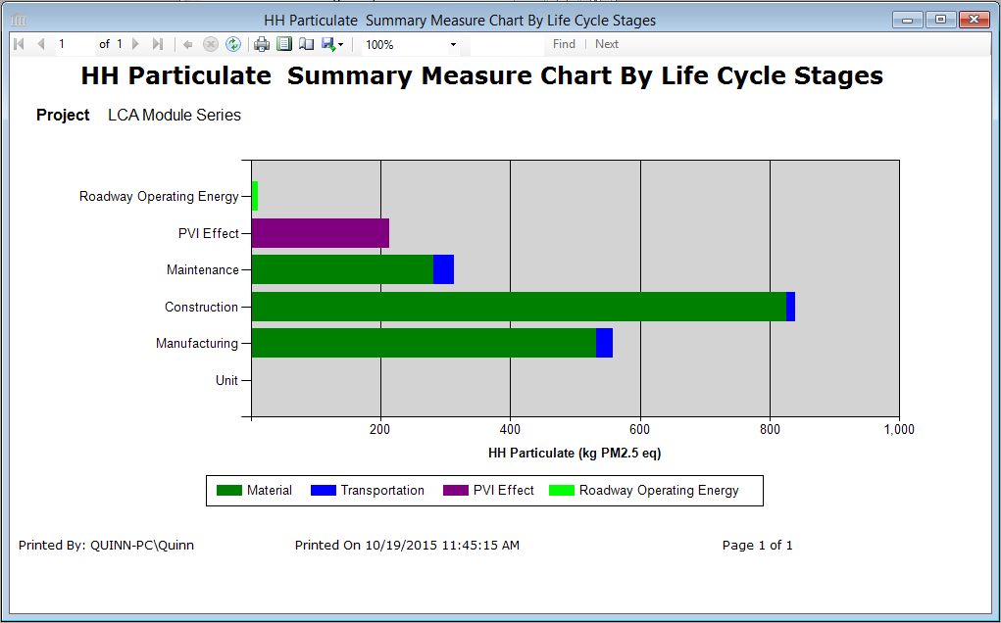
Results Graph

Slide 14

Results Table

Slide 15
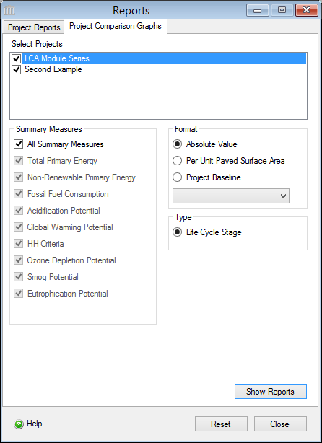
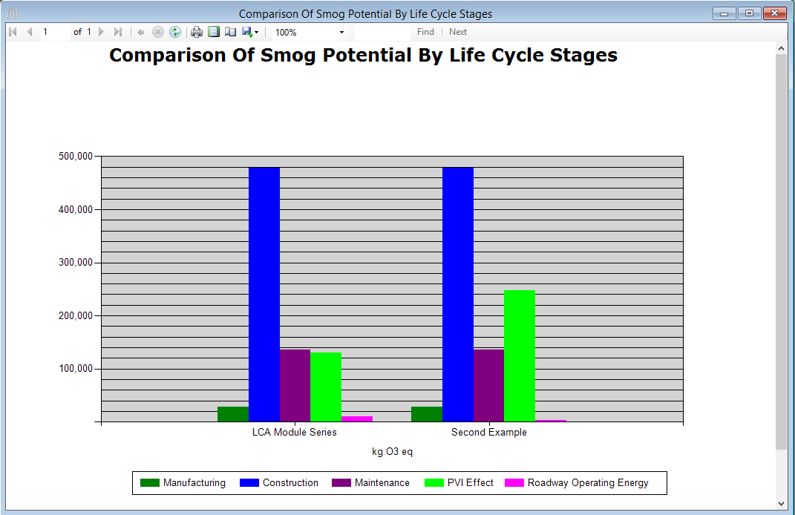
Comparative Results

Slide 16
Thank you for completing Module τ4!
Group A: ISO Compliant LCA Overview Modules
Group α: ISO Compliant LCA Detailed Modules
Group B: Environmental Impact Categories Overview Modules
Group β: Environmental Impact Categories Detailed Modules
Group G: General LCA Tools Overview Modules
Group γ: General LCA Tools Detailed Modules
Group T: Transportation-Related LCA Overview Modules
Group τ: Transportation-Related LCA Detailed Modules

