Slide 1

Welcome to the Life Cycle Assessment (LCA) Learning Module Series
Liv Haselbach Quinn Langfitt
For current modules email haselbach@wsu.edu or visit cem.uaf.edu/CESTiCC
Acknowledgements:
CESTiCC Washington State University Fulbright

Slide 2
LCA Module Series Groups
Group A: ISO Compliant LCA Overview Modules
Group α: ISO Compliant LCA Detailed Modules
Group B: Environmental Impact Categories Overview Modules
Group β: Environmental Impact Categories Detailed Modules
Group G: General LCA Tools Overview Modules
Group γ: General LCA Tools Detailed Modules
Group T: Transportation-Related LCA Overview Modules
Group τ: Transportation-Related LCA Detailed Modules

Slide 3
Free LCA Software Tools (Non-Transportation)
Module G2

Slide 4
Free Tools
Two types of free software tools
Interface only
Fully packaged tool with free data included
Few options of this type
  OpenLCA
  CMLA
Some of the more advanced modeling features from paid tools available
Manual entry of data or purchase a database like ecoinvent
Streamlined modeling process
No environmental data collection
Sometimes application specific
  Athena IE for buildings
  PaLATE for pavement
  GREET for vehicles
Typically less data transparency and advanced modeling options

Slide 5
Free Tools
We will cover four common tools in this module:
  OpenLCA (by GreenDelta in Germany)
  Building for Environmental and Economic Sustainability (BEES) (by NIST in the United States)
  Athena Impact Estimator for Buildings (by Athena Sustainable Materials Institute in Canada)
  Economic Input-Output Life Cycle Assessment (EIO-LCA) (by Carnegie Mellon University in the United States)
There are other free tools out there as well that are not included
This module meant as an overview, a couple of these programs might be demonstrated in more detail in the gamma modules
Some transportation specific programs (most of which are free) are covered in Module G3
Carbon footprint only software might be covered in the gamma modules

Slide 6

openLCA
Produced by GreenDelta, run on an open source platform
Includes advanced features like parameterization, Monte Carlo simulation, Sankey diagrams, etc.
No life cycle inventory databases pre-installed
  Option a – manual entry
  Option b - some free databases available such as
    USDA (US agricultural datasets)
    USLCI (from NREL)
    NEEDS (Industrial LCI data for future electricity supplies in Europe)
    ELCD (JRC European Commission general data)
  Option c – paid databases such as
    ecoinvent
    GaBi
    Others

Slide 7
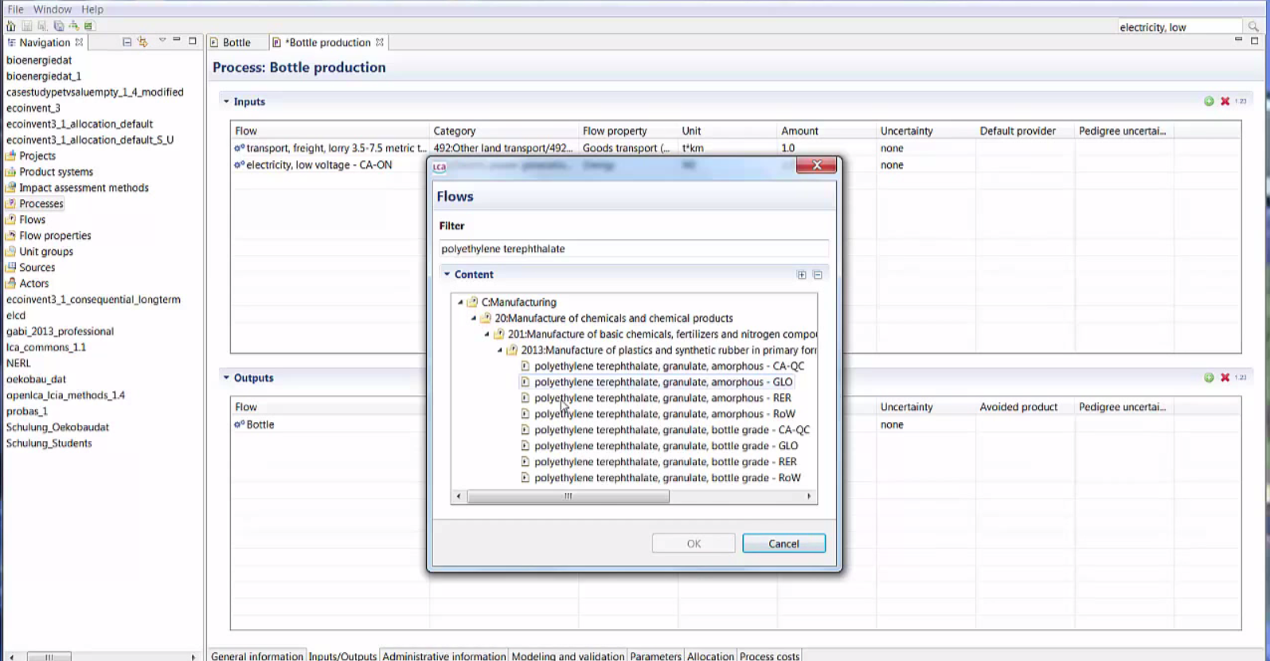
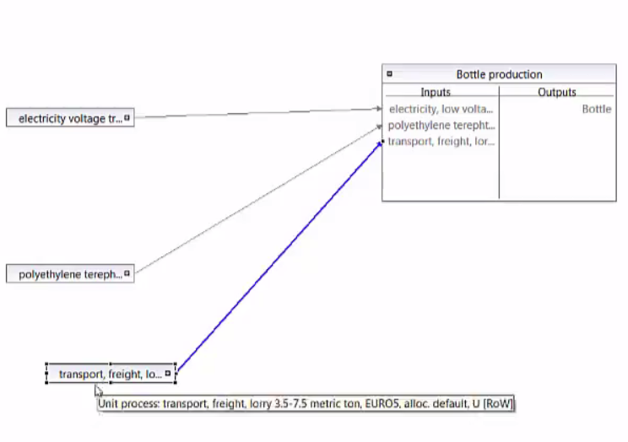
openLCA Input

Slide 8
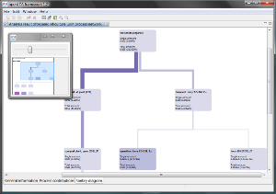
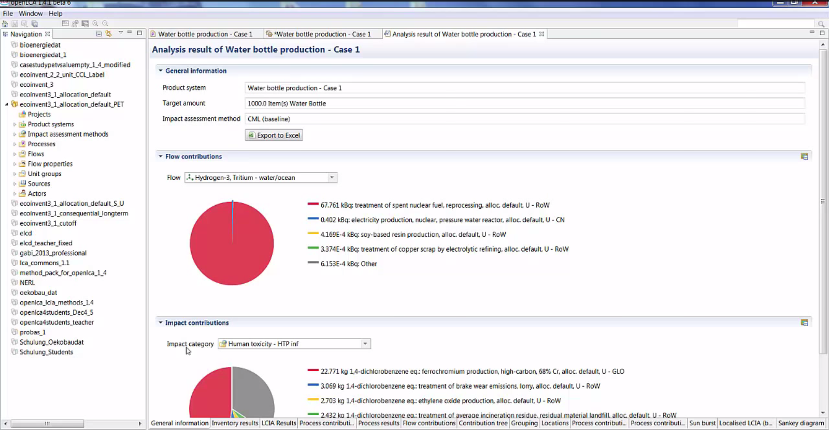
openLCA Output

Slide 9

Building for Environmental and Economic Sustainability (BEES)
For environmental and economic
analysis of building products
Online-based tool
Produced by NIST in the US
Nearly 200 products included
  Concrete, roofing, insulation, water distribution piping, cleaning materials, paving, more
Simple to use
  Most data and processes set, just choose weighting scheme, product(s) of interest, and transport distance
Less control than paid software and openLCA
  Modelling parameters, sensitivity analyses, manual changing of inputs/outputs not available

Slide 10
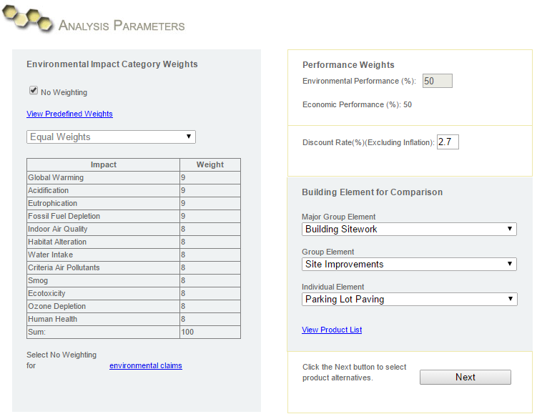
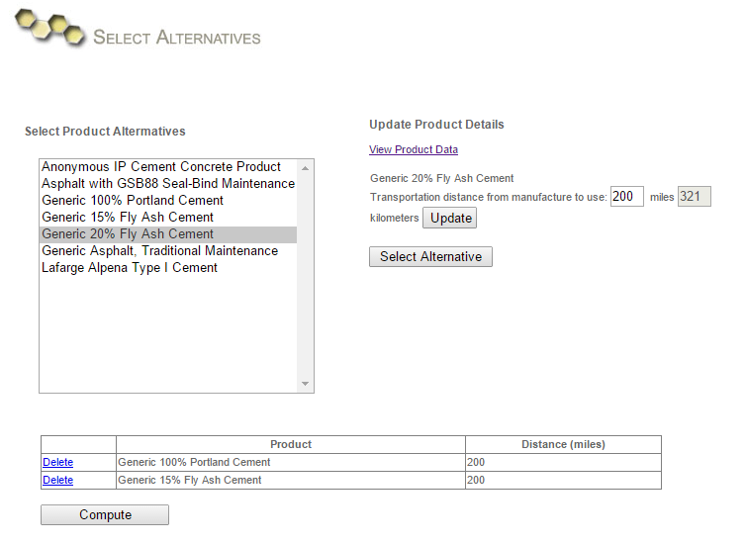
BEES Input

Slide 11
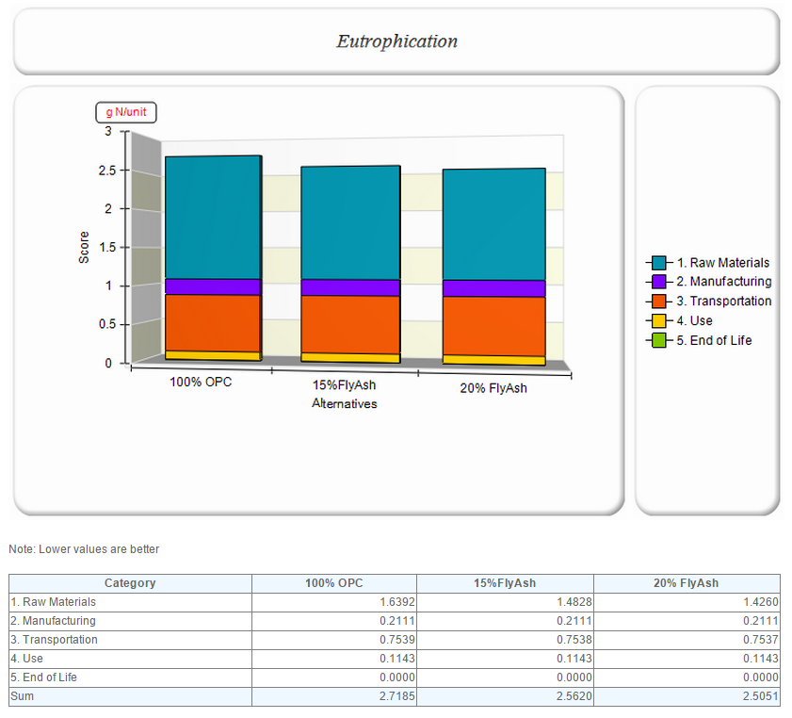
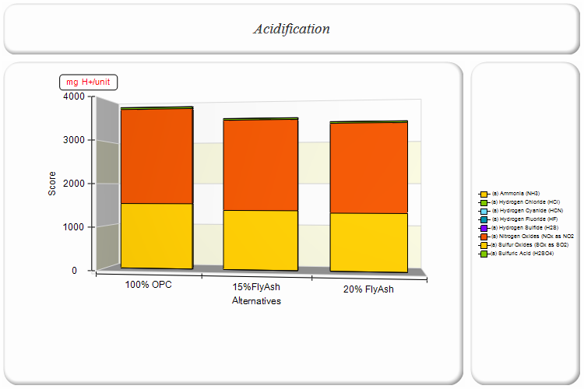
BEES Output
By life cycle stage
By environmental flow

Slide 12


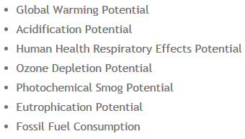
Athena IE
Recently made free!
Choices:
  Impact Estimator for Buildings
  Impact Estimator for Highways (covered in Module G3)
  EcoCalculator: Simple spreadsheet tool, no longer supported with updates
Impact Estimator for Buildings
  Available free as download
  Can model 95% of the North American building stock
  Geographic region specific
  Uses dialog boxes to ask for specific building parameters
    Such as width, span, and live load of a floor assembly
  Models results with TRACI for these impact categories
  Developed specifically for use by architects, engineers, and sustainable design consultants

Slide 13
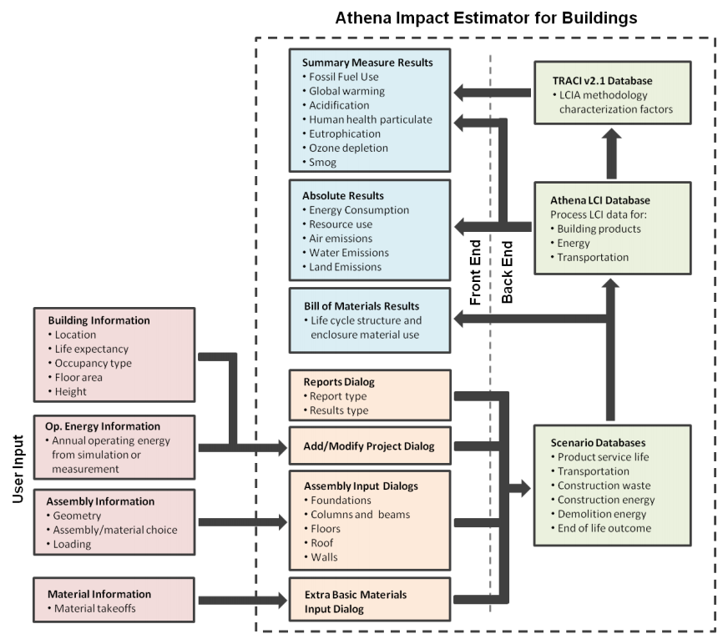
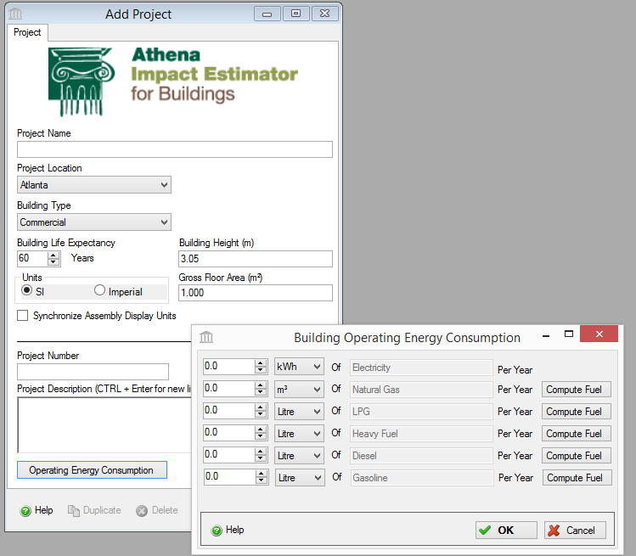
Athena Impact Estimator

Slide 14






Economic Input-Output Life Cycle Assessment (EIO-LCA)
Free web-based tool
Produced by Carnegie Mellon University
Calculates results based on economic ties between sectors
Assessment based on economic activity input by the user in a sector
  Producer
  Purchaser
Many datasets to choose from including:
  1992, 1997, and 2002 US producer
  1997 and 2002 US purchaser
  2002 West Virginia and Pennsylvania producer
  Germany, Spain, Canada, and China producer
Includes product types in a wide variety of industries
  428 in total for US 2002 data
Producer Models for these Countries
*Flag maps not to scale Flag maps other than Canada source: commons.wikimedia.org Canada: mapsof.net

Slide 15
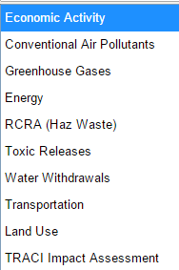

Economic Input-Output Life Cycle Assessment (EIO-LCA)
Can output results in a number of ways
Results can be downloaded as Excel file
Carnegie Mellon logo source: cmu.edu

Slide 16
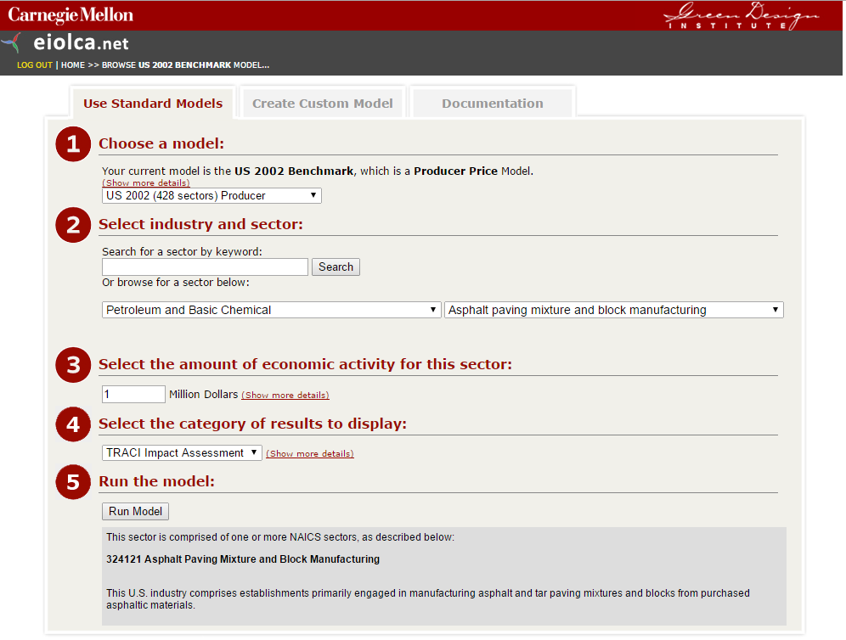
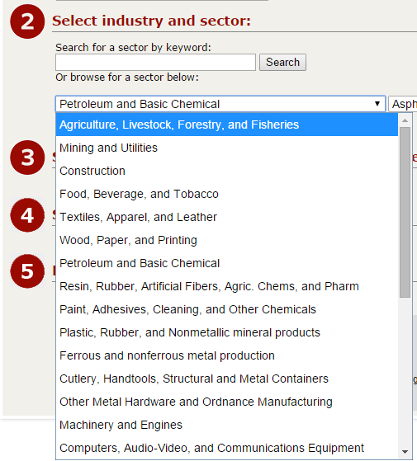
EIO-LCA Input

Slide 17
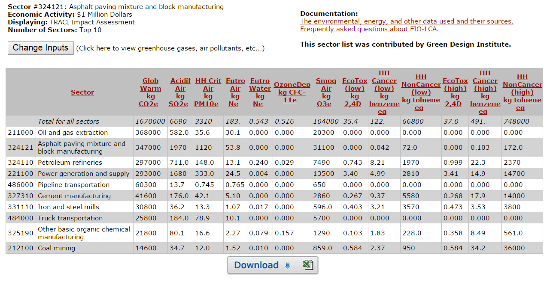
EIO-LCA Output
Carnegie Mellon University Green Design Institute. (2015) Economic Input-Output Life Cycle Assessment (EIO-LCA) US 2002 (428 sectors) Producer model[Internet], Available from: <http://www.eiolca.net/>

Slide 18
Thank you for completing Module G2!
Group A: ISO Compliant LCA Overview Modules
Group α: ISO Compliant LCA Detailed Modules
Group B: Environmental Impact Categories Overview Modules
Group β: Environmental Impact Categories Detailed Modules
Group G: General LCA Tools Overview Modules
Group γ: General LCA Tools Detailed Modules
Group T: Transportation-Related LCA Overview Modules
Group τ: Transportation-Related LCA Detailed Modules

Slide 19
Self-Assessment Quiz
MODULE G2: General Free LCA Tools

Slide 20
Which of these tools deviates from the standard process-based approach to calculating LCA results?
openLCA
BEES
Athena IE for Buildings
EIO-LCA

Slide 21
Correct!
The EIO-LCA uses economic-input output matrices to track impacts from various sectors through ties in economic relationships, not through directly tracking inputs and outputs of processes and flows of a product system.

Slide 22
Which of these tools allows for direct integration of the ecoinvent database?
openLCA
BEES
Athena IE for Buildings
EIO-LCA

Slide 23
Correct!
openLCA is the only tool covered in this module that allows for full integration of databases, including ecoinvent, GaBi databases, the US LCI, and more.

Slide 24
Which of these is not an option for BEES results display?
By life cycle stage
By flow
By unit process

Slide 25
Correct!
BEES output can take a number of forms including by life cycle stage, by environmental flow, and by weighted total environmental “score”. However, results cannot be displayed by unit process.

Slide 26
The Athena Impact Estimator can model LCA results which impact methodology?
CML
IMPACT2002+
TRACI
All of the above

Slide 27
Correct!
The Athena Impact Estimator calculates LCA results using the TRACI methodology. However, it does not calculate the human toxicity or ecotoxicity results that are usually a part of TRACI.

Slide 28
Which country (besides the US) has a producer model available in the EIO-LCA?
Germany
Canada
Spain
China
All of the above

Slide 29
Correct!
Besides having producer and purchaser models available for the United States, the EIO-LCA also has producer models for Germany, Canada, Spain, and China.

Slide 30
Sorry that’s Incorrect
Please try again!

